Slide 1
Graphics KI revision
Quiz 3

Slide 2
40 Multiple choice Questions
10 seconds per question
1 Mark Each

Slide 3
Write down the correct letter
and
write down the correct answer or symbol

Slide 4
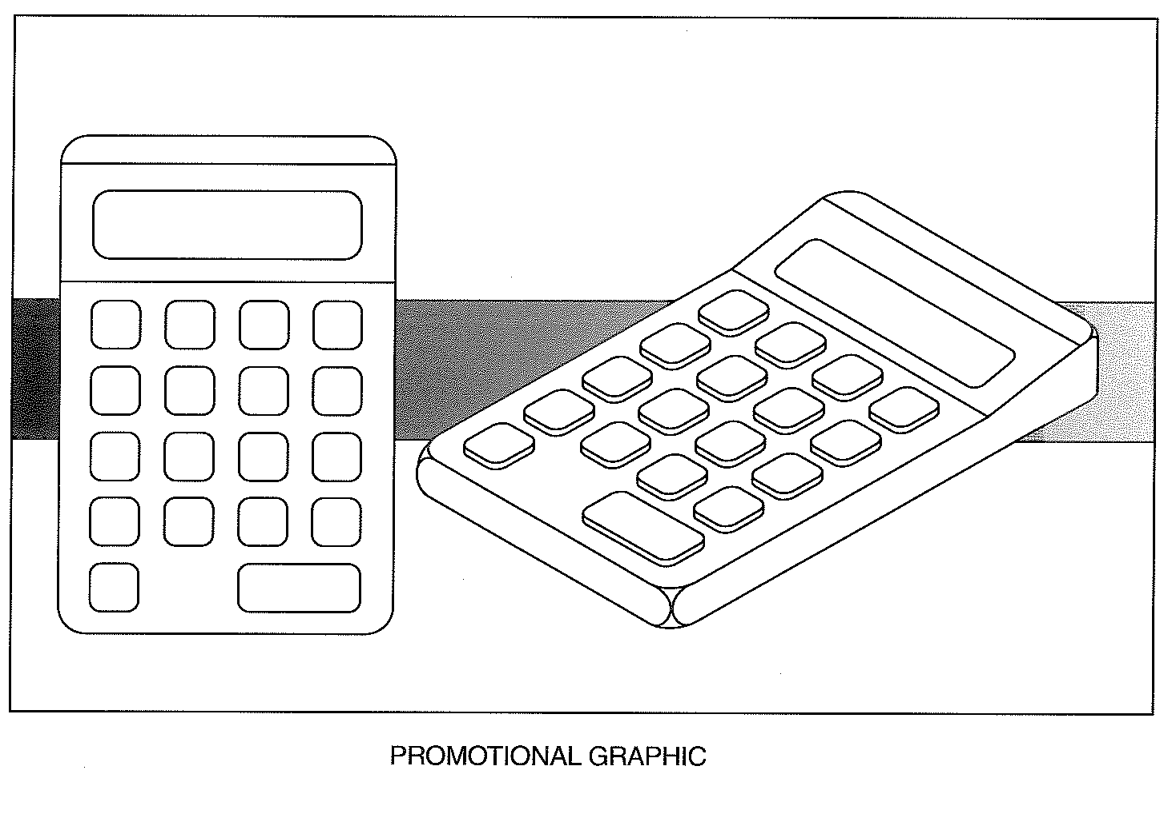
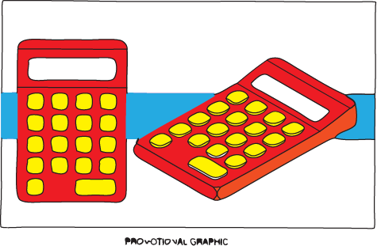
Q1 – KI Revision –Credit Questions
The colour scheme is very important when marketing a new product. With reference to the calculator below state the impression created by the following colour scheme.
Red casing, yellow buttons and red trim
2003 C

Slide 5
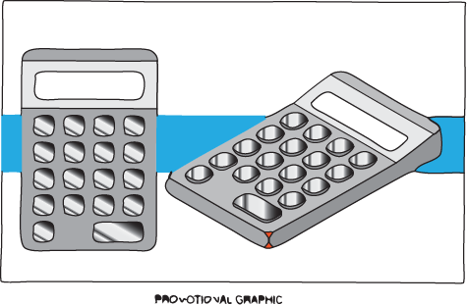
Q2 – KI Revision –Credit Questions
The colour scheme is very important when marketing a new product. With reference to the calculator below state the impression created by the following colour scheme.
Grey casing, Silver buttons and silver trim
2003 C

Slide 6
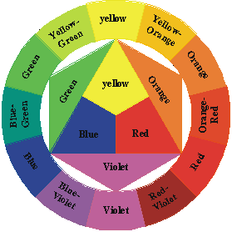
Q3 – KI Revision –Credit Questions
The calculator is to be packaged in a cardboard box.
Suggest a background colour that would represent reliability.
Not given in exam question
2003 C

Slide 7
Q4 – KI Revision –Credit Questions
The calculator is to be packaged in a cardboard box.
Suggest a text colour that contrasts with the backgroundc olour.
Not given in exam question
2003 C

Slide 8
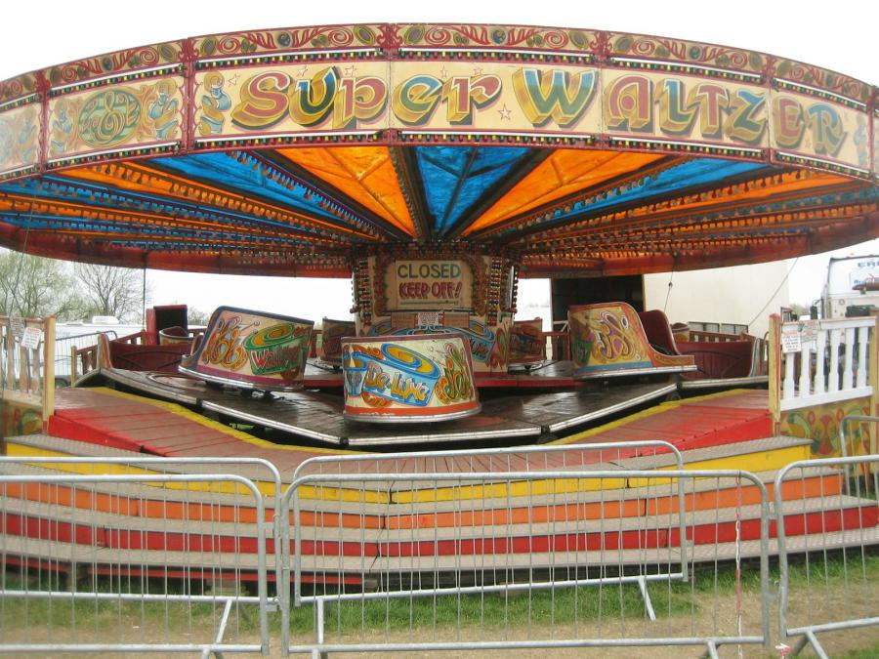
Q5 – KI Revision –Credit Questions
The colour scheme of a new fairground attraction should be bright and highly visible with lots of contrast. Yellow is chosen as one of the colours.
State two colours that could be used with yellow to create this scheme?
Not given in exam question
2006 C

Slide 9
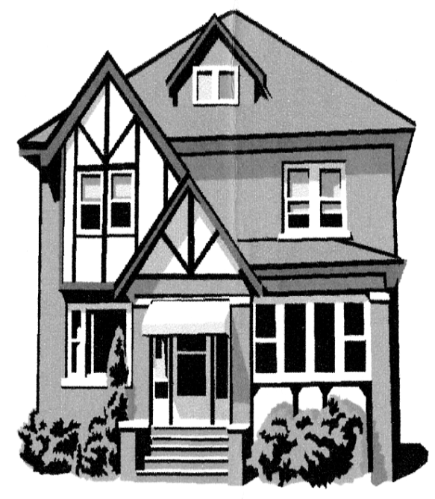
Q7 – KI Revision –Credit Questions
Architects find using computers of great benefit when producing new designs.
Explain what is meant by the term layering when applied to CAG and state one example of how layering can be used in in a new house design.
2006 C

Slide 10
Solutions

Slide 11
Q1 – KI Revision –Solutions
The colour scheme is very important when marketing a new product. With reference to the calculator below state the impression created by the following colour scheme.
Red casing, yellow buttons and red trim
Visual excitement, Attractive to children, Feeling of warmth
2003 C

Slide 12
Q1 – KI Revision –Credit Questions
The colour scheme is very important when marketing a new product. With reference to the calculator below state the impression created by the following colour scheme.
Grey casing, Silver buttons and silver trim
To look sophisticated, expensive, Hi Tech, dignified, modern
neutral
2003 C

Slide 13
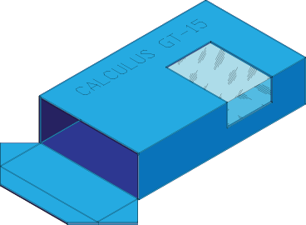
Q3 – KI Revision – Credit Questions
The calculator is to be packaged in a cardboard box.
Suggest a colour that would contrast with the chosen background colour .
Blue or brown
2003 C

Slide 14
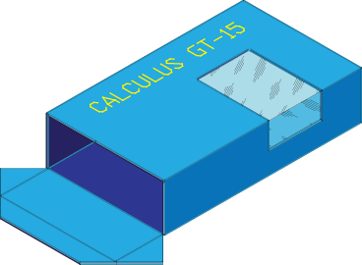
Q4 – KI Revision – Credit Questions
The calculator is to be packaged in a cardboard box.
Suggest a text colour that contrasts with the background.
Blue background – Yellow, yellow-green
Brown background – blue violet, violet
2006 C

Slide 15
Q5 – KI Revision –Credit Questions
The colour scheme of a new fairground attraction should be bright and highly visible with lots of contrast. Yellow is chosen as one of the colours.
State two colours that could be used with yellow to create this scheme?
Not given in exam question
Blue and red
2006 C

Slide 16
Q7 – KI Revision –Credit Questions
Architects find using computers of great benefit when producing new designs.
Explain what is meant by the term layering when applied to CAG and state one example of how layering can be used in in a new house design.
Drawing different aspects or parts of a drawing on separate layers. These can be viewed separately or together. I.e. walls, dimensions, electrics and plumbing all drawn on separate layers
2006 C

