Slide 1
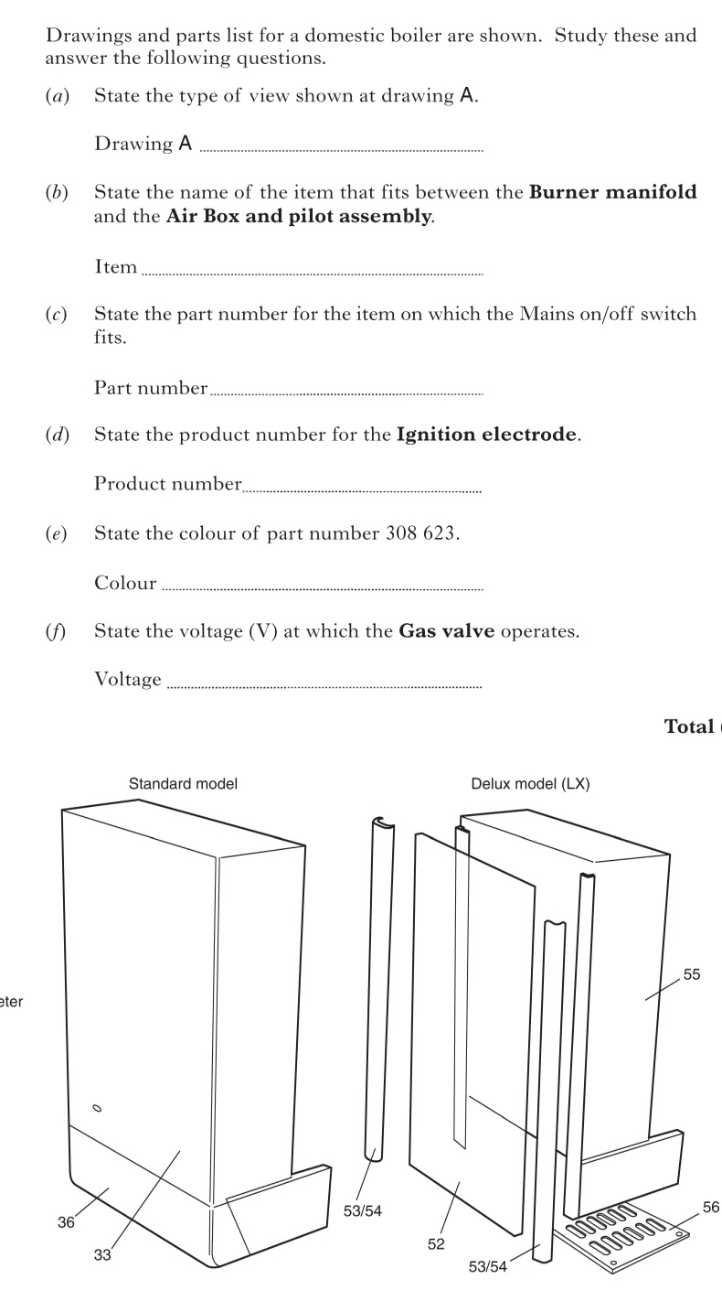
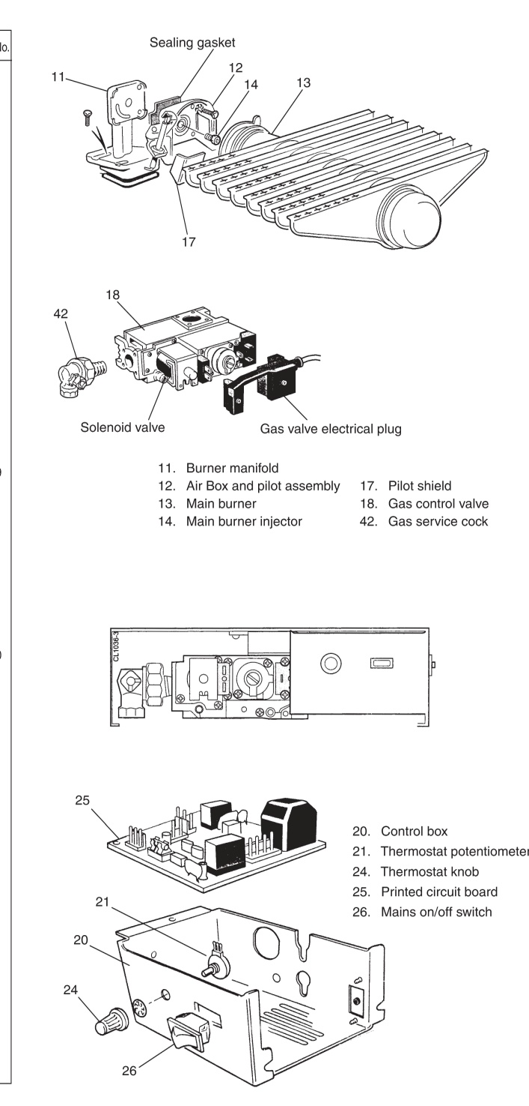
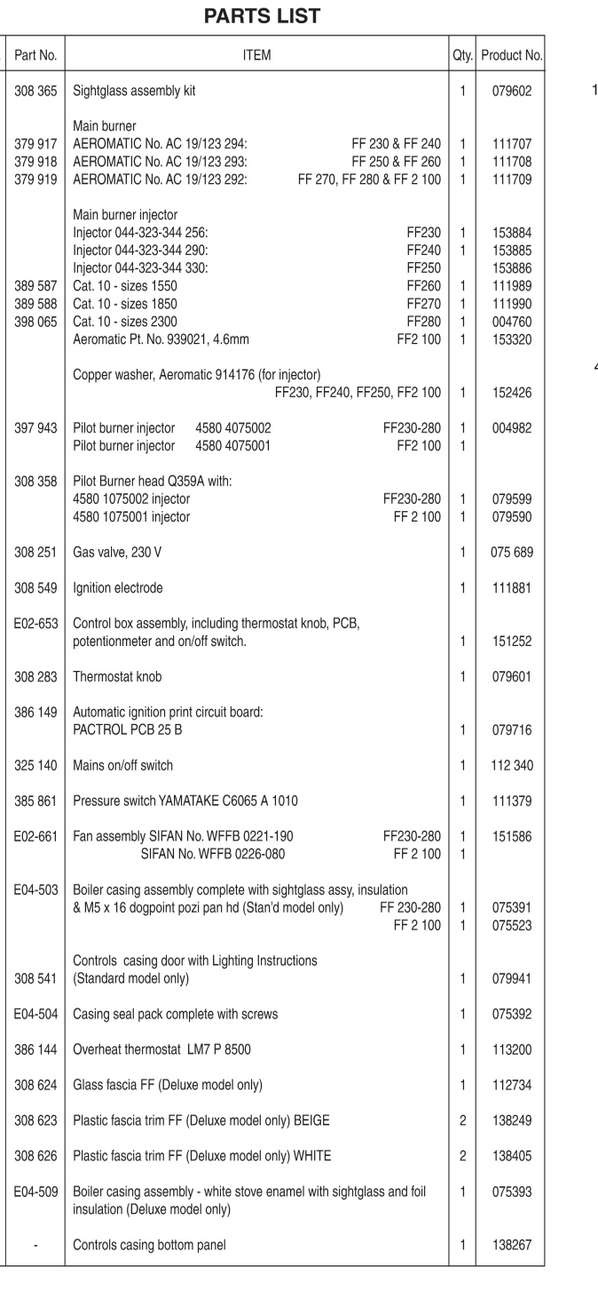
Standard Grade Graphic Communication Credit KI 2004 Q1
Index
1.
Exploded isometric
Sealing gasket
Drawing A
EO2-653
111881
Beige
230 V

Slide 2
Standard Grade Graphic Communication Credit KI 2004 Q2
Index
2.
Easier to edit/ Cheaper to make
Can be sent by E-Mail/Modem
Easier to store/ Faster to produce
Wire frame
Surface
Solid
Safer
Different conditions can be simulated
More cost effective than using a real car

Slide 3
Standard Grade Graphic Communication Credit KI 2004 Q3
Index
3.
Cleanliness
Blue
Blue
Blue-green/Green/Blue- violet/violet
Safe
Bright, attractive
Stands out, Contrast with floor
Red
Blue/Green/Blue-green etc
Red/Blue/Blue-Violet etc
Contrasts with Yellow
Add any primary with a secondary colour.
Visual excitement

Slide 4
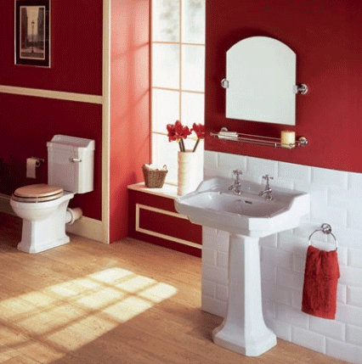
Standard Grade Graphic Communication Credit KI 2004 Q4
Index
4.
Cost of equipment
Cost of Training
Need to upgrade software
Possible computer crashes
Hacking
Viruses
DTP – Desk Top Publishing
CAD – Computer aided Drawing
Illustration or Paint package
Laser
Plotter (any type)
Easier to Edit
Scanner
Digitiser
Use of Library parts
Digital camera
Graphics tablet
Accuracy
Less storage space
E-mail capabilities
Reduced lead time

