Slide 1
Graphics KI revision
Quiz 2

Slide 2
40 Multiple choice Questions
10 seconds per question
1 Mark Each

Slide 3
Write down the correct letter
and
write down the correct answer or symbol

Slide 4
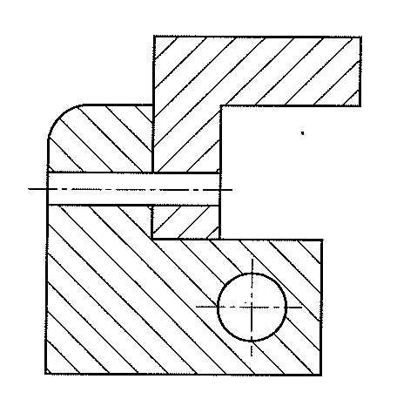
Q1 – KI Revision
10
9
8
7
6
5
4
3
2
1
0
What type of drawing is shown below?
Is it a:-
A. Isometric
B. Section
C. Plan

Slide 5
Q2 – KI Revision
10
9
8
7
6
5
4
3
2
1
0
What type of line is this?
Line type?
Is it a:-
A. Outline
B. Hatch line
C. Hidden detail

Slide 6
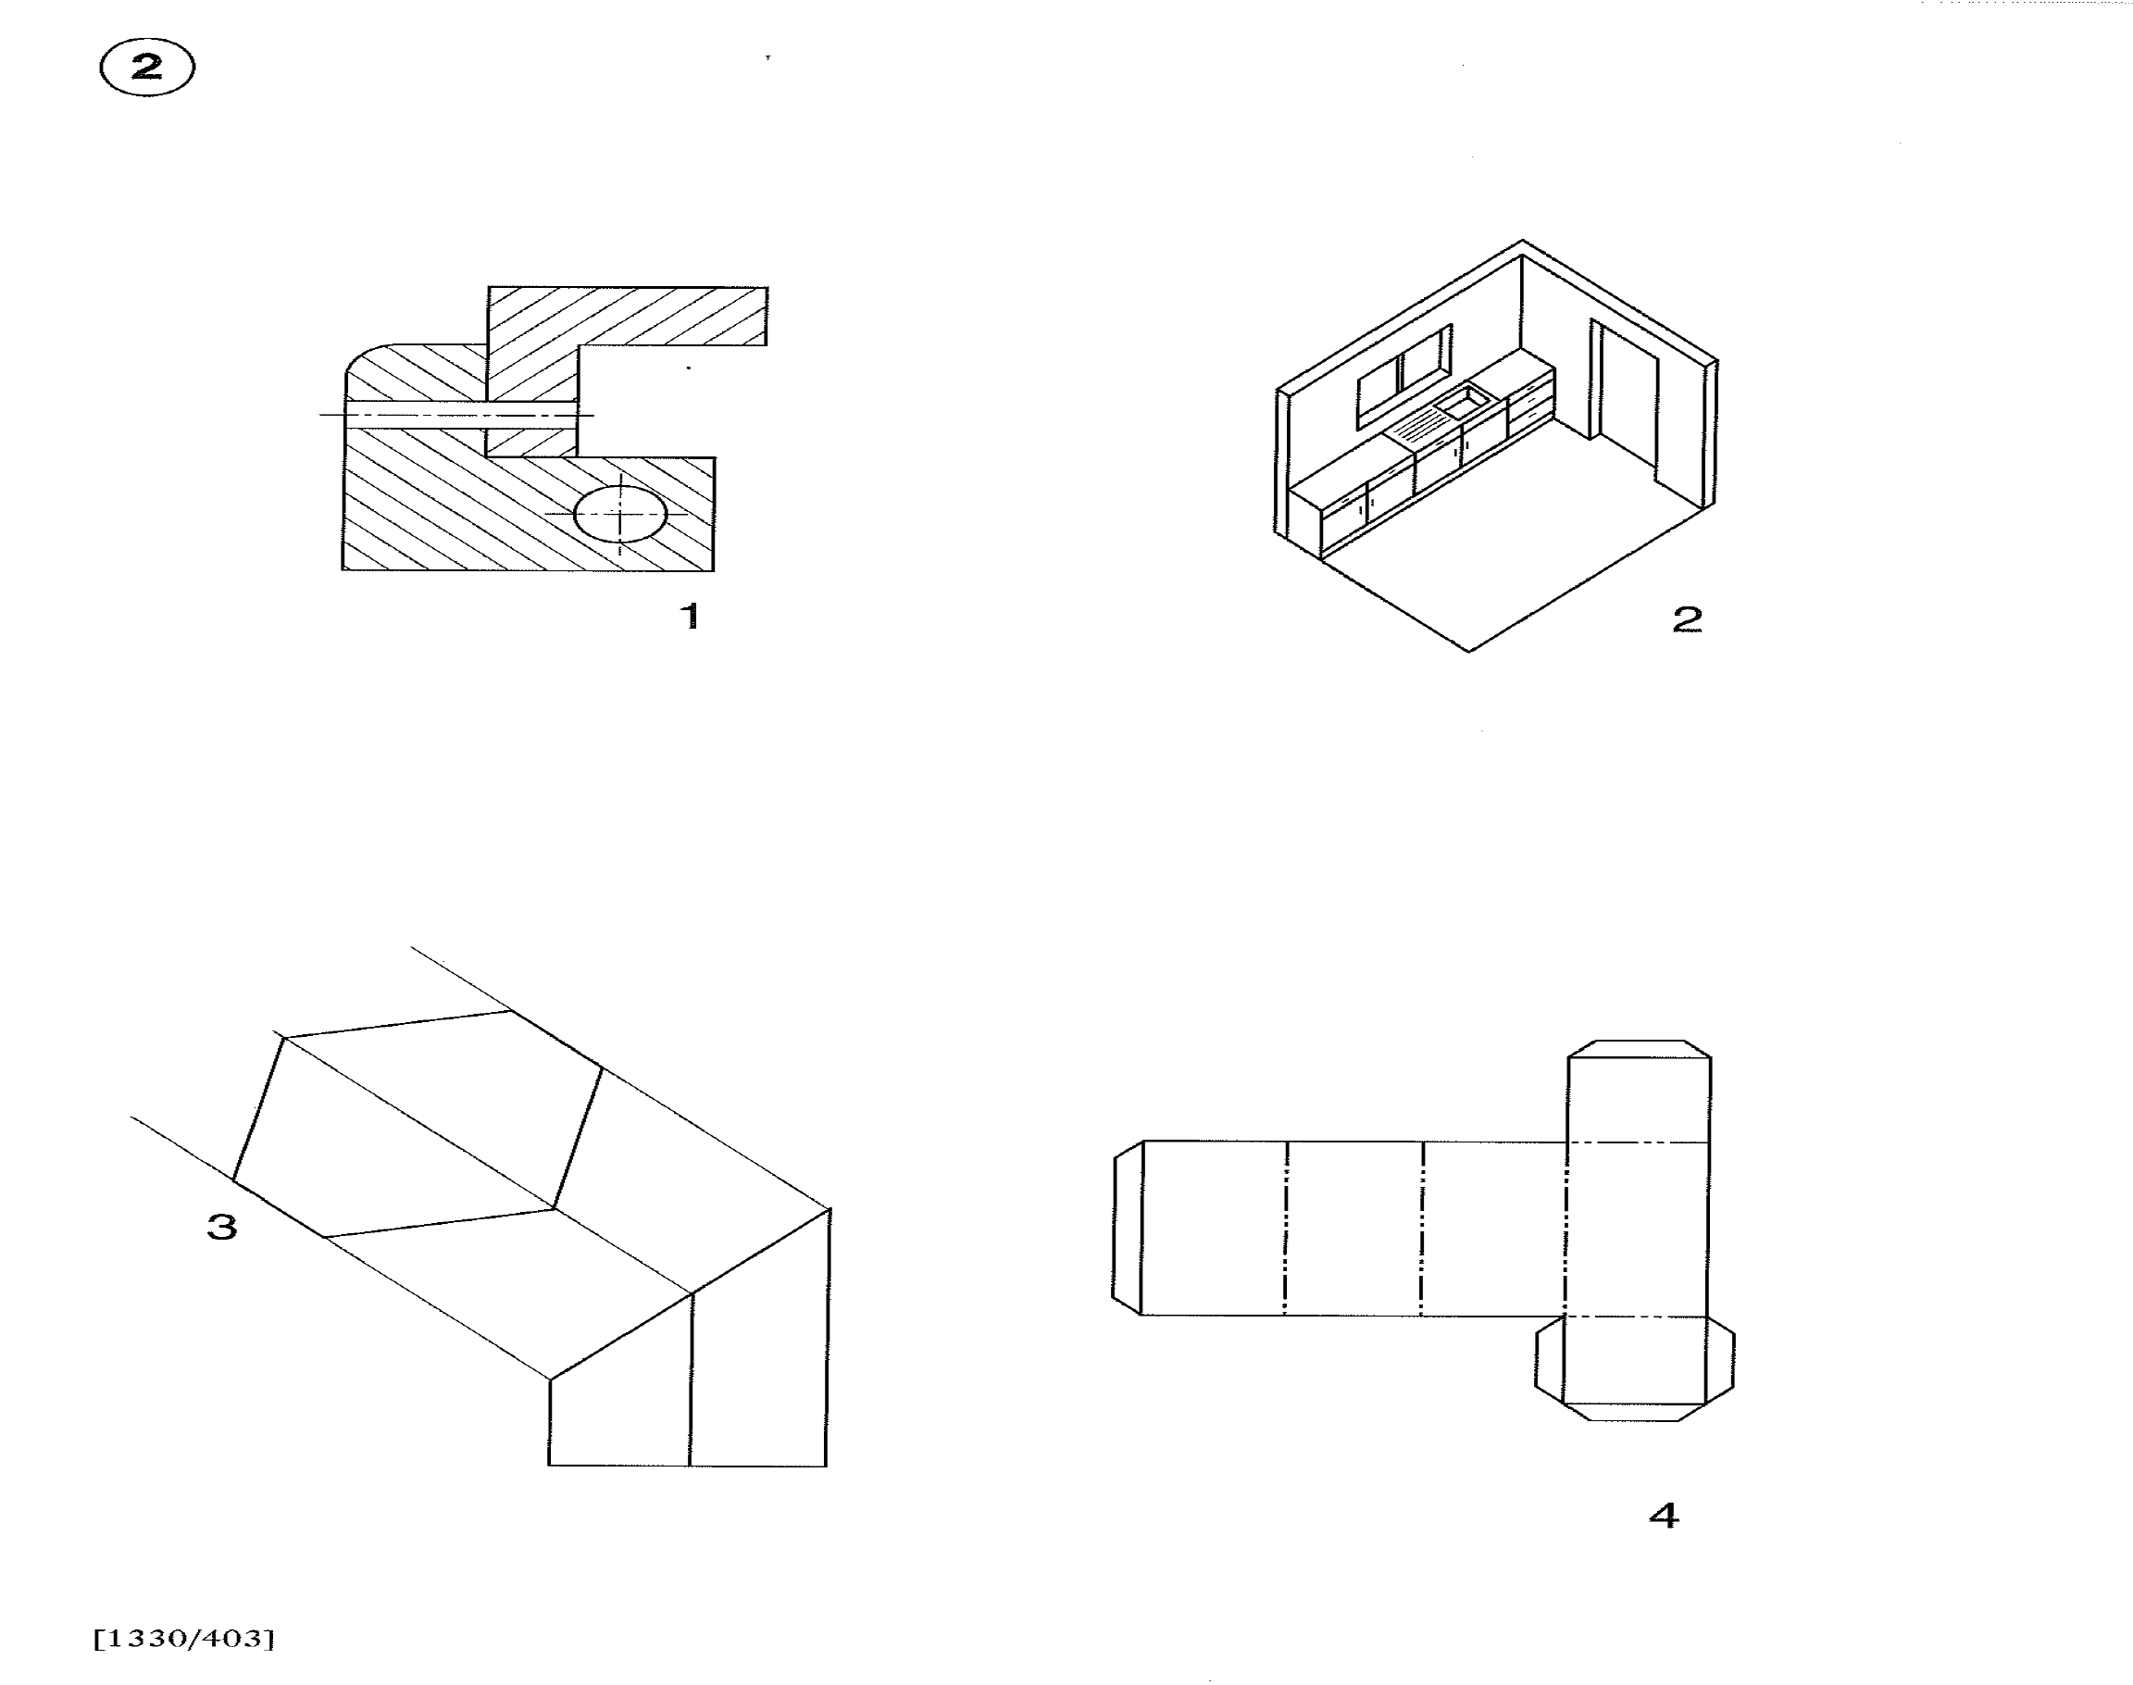
Q3 – KI Revision
10
9
8
7
6
5
4
3
2
1
0
What type of pictorial drawing is this?
45°
45°
A. Isometric
B. Oblique
C. Planometric

Slide 7
Q4 – KI Revision
10
9
8
7
6
5
4
3
2
1
0
What type of drawing is this?
A. Isometric
B. development
C. Planometric

Slide 8
Q5 – KI Revision
10
9
8
7
6
5
4
3
2
1
0
What type of line is this?
Line type?
A. Centre line
B. Fold line
C. Section line

Slide 9
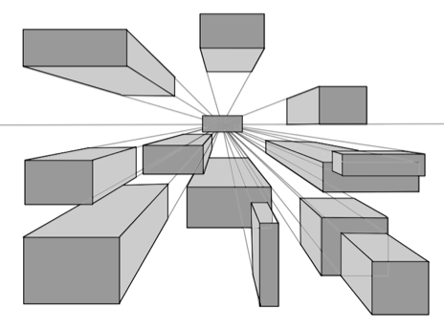
Q6 – KI Revision
10
9
8
7
6
5
4
3
2
1
0
What type of drawings are these?
A. Isometric
B. Planometric
C. 1 point perspective

Slide 10
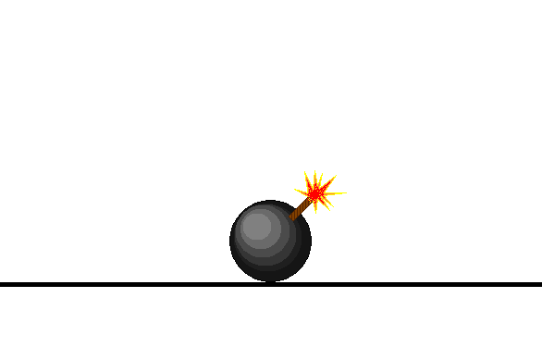
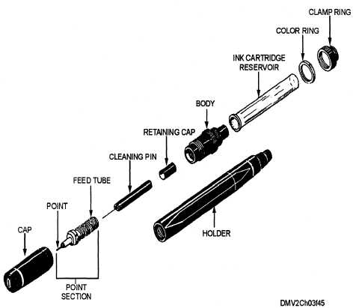
Q7 – KI Revision
10
9
8
7
6
5
4
3
2
1
0
What type of drawings is this?
A. Penometric
B. Inkometric
C. Exploded isometric

Slide 11
Q8 – KI Revision
10
9
8
7
6
5
4
3
2
1
0
What type of drawing is this?
A. 2 point perspective
B. Isometric
C. 1 point perspective
30°
30°

Slide 12
Q9 – KI Revision
10
9
8
7
6
5
4
3
2
1
0
What type of Line is this?
A. Fold line
B. Hidden detail Line
C. Centre line
Line type?

Slide 13
Q10 – KI Revision
10
9
8
7
6
5
4
3
2
1
0
What type of drawing is this?
A. One point perspective
B. Oblique
C. Two point perspective

Slide 14
Q11 – KI Revision
10
9
8
7
6
5
4
3
2
1
0
What do the letters VP stand for?
VP1
VP2
A. Very pretty
B. Vanishing point
C. Vertical plane

Slide 15
Q12 – KI Revision
10
9
8
7
6
5
4
3
2
1
0
What is the name given to this line?
VP1
VP2
Name the Line?
A. Horizontal
B. Horizon
C. Horrible

Slide 16
Q13 – KI Revision
10
9
8
7
6
5
4
3
2
1
0
What type of drawing is this?
A. Isometric
B. oblique
C. Planometric
45°

Slide 17
Q14 – KI Revision
10
9
8
7
6
5
4
3
2
1
0
To make this type of drawing more visually appealing . What is done on the Z-axis ?
A. Double the sizes
Z axis
B. Halve the sizes
C. Guess the sizes

Slide 18
Q15 – KI Revision
10
9
8
7
6
5
4
3
2
1
0
What type of line is this?
A. Hidden detail line
B. Fold line
A
Line type?
C. Section line
A

Slide 19

Q16 – KI Revision
10
9
8
7
6
5
4
3
2
1
0
What type of Drawing is this?
A. Floor map
B. Floor plan
C. Floor mop

Slide 20
Q17 – KI Revision
10
9
8
7
6
5
4
3
2
1
0
What type of Drawing is this?
A. Site plan
B. Smith Plan
C. Location plan

Slide 21
Q18 – KI Revision
10
9
8
7
6
5
4
3
2
1
0
What type of Drawing is this?
A. Location plan
B. Floor Plan
C. Site plan

Slide 22
Q19 – KI Revision
10
9
8
7
6
5
4
3
2
1
0
What does this symbol mean on a drawing?
A Millimetres
B. 1st angle projection
C. 3rd angle projection

Slide 23

Q20 – KI Revision
10
9
8
7
6
5
4
3
2
1
0
What does this symbol mean on a Package?
A Bows and arrows ahead
B. Look up
C. This way up

Slide 24

Q21 – KI Revision
10
9
8
7
6
5
4
3
2
1
0
What does this symbol mean on a package?
A Wine for sale
B. Glasses for sale
C. Fragile

Slide 25

Q22 – KI Revision
10
9
8
7
6
5
4
3
2
1
0
What does this symbol mean on a Package?
A Expect rain
B. Waterproof
C. Keep dry

Slide 26
Q23 – KI Revision
10
9
8
7
6
5
4
3
2
1
0
What do these letters mean on a drawing?
AF
A Automatic Focus
B. Across the Flats
C. Almost Finished

Slide 27

Q24 – KI Revision
10
9
8
7
6
5
4
3
2
1
0
What do these letters mean on a drawing?
AC
A Across the Corners
B. Alternating Current
C. Half a rock band

Slide 28
Q25 – KI Revision
10
9
8
7
6
5
4
3
2
1
0
What does this symbol mean when it is put before a dimension on a drawing?
example
60
Oops!!!!
A Square
B. Squint
C. Box

Slide 29
Q25 – KI Revision
10
9
8
7
6
5
4
3
2
1
0
What does this symbol mean when it is put before a dimension on a drawing?
example
60
A Square
B. Squint
C. Box

Slide 30
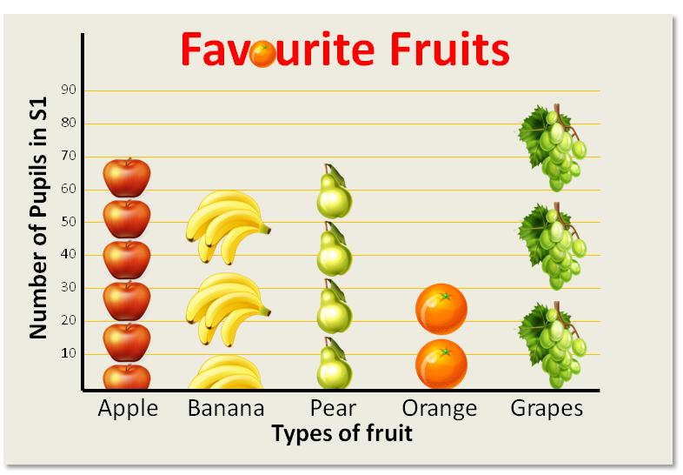
Q26 – KI Revision
10
9
8
7
6
5
4
3
2
1
0
What type of graph is this?
A Pie chart
B. Pictogram
C. Fruitogram

Slide 31

Q27 – KI Revision
10
9
8
7
6
5
4
3
2
1
0
What type of graph is this?
Y-axis
25
20
15
10
5
Temperature °C
0
-5
-10
X-axis
Jan
Feb
Mar
Apr
May
Jun
Jul
Aug
Sep
Oct
Nov
Dec
TIME
Just giving you a bit of a breather
A Crawl graph
B. Line Graph
C. Bar Graph

Slide 32
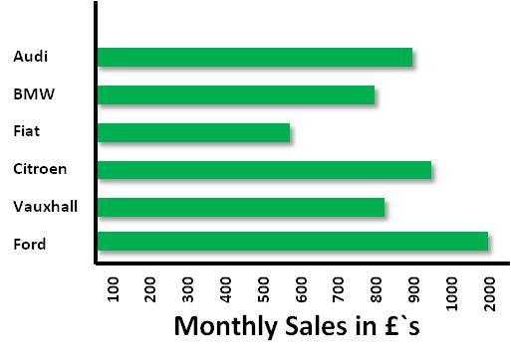
Q28 – KI Revision
10
9
8
7
6
5
4
3
2
1
0
What type of graph is this?
A Pie chart
B. Pictogram
C. Bar Chart

Slide 33
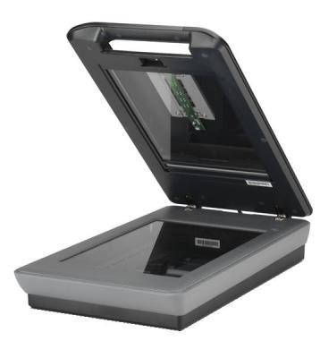
Q29 – KI Revision
10
9
8
7
6
5
4
3
2
1
0
What type of input device is this?
A Ink jet printer
B. Hand Scanner
C. Flat bed scanner

Slide 34
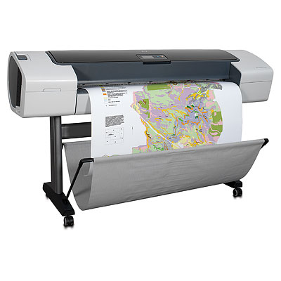
Q30 – KI Revision
10
9
8
7
6
5
4
3
2
1
0
What type of input device is this?
A Flat bed plotter
B. Symbol blotter
C. Drum plotter

Slide 35
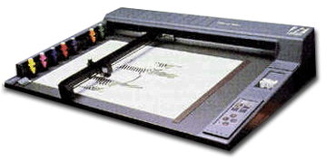
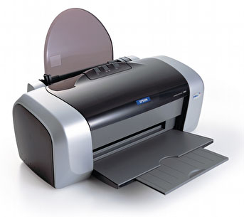
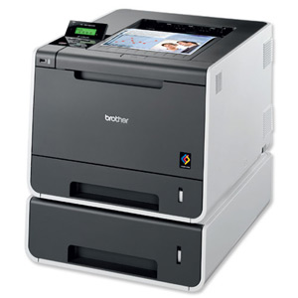
Q31 – KI Revision
10
9
8
7
6
5
4
3
2
1
0
What type of devices can not produce images containing tones such as photographs?
A. Flat bed plotter
B. Ink jet printer
C. Laser Printer

Slide 36
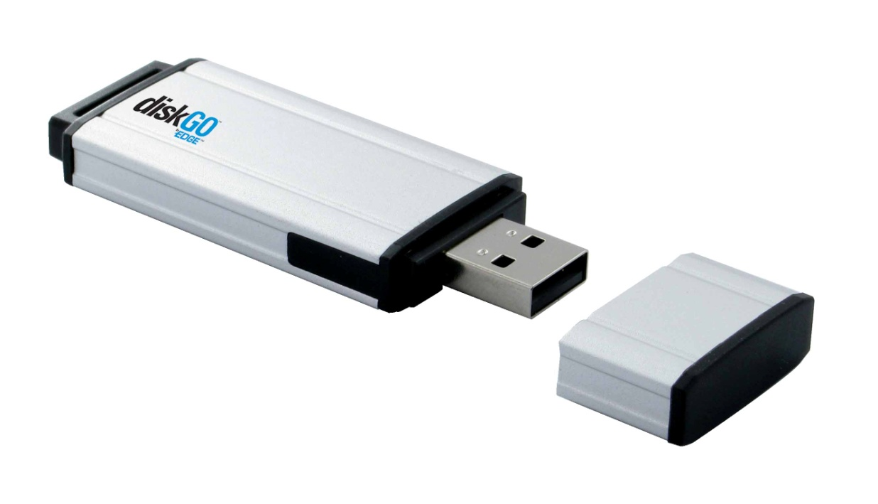
Q32 – KI Revision
10
9
8
7
6
5
4
3
2
1
0
What is the name given to this type of storage device?
A. Compact Disc
B. Hard drive
C. Flash drive

Slide 37
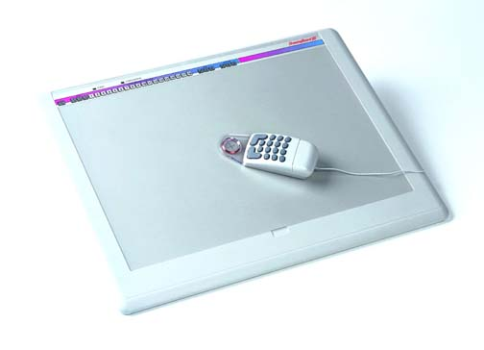
Q33 – KI Revision
10
9
8
7
6
5
4
3
2
1
0
What is the name given to a device used to convert manual drawings to digital?
A. Sterilising tablet
B. Dishwasher tablet
C. Digitising tablet

Slide 38
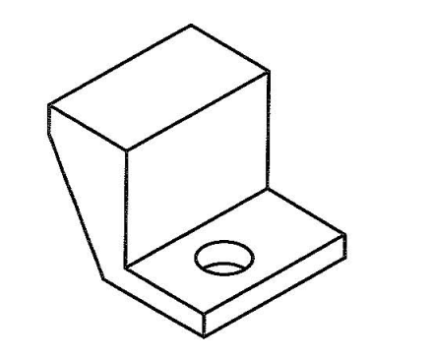
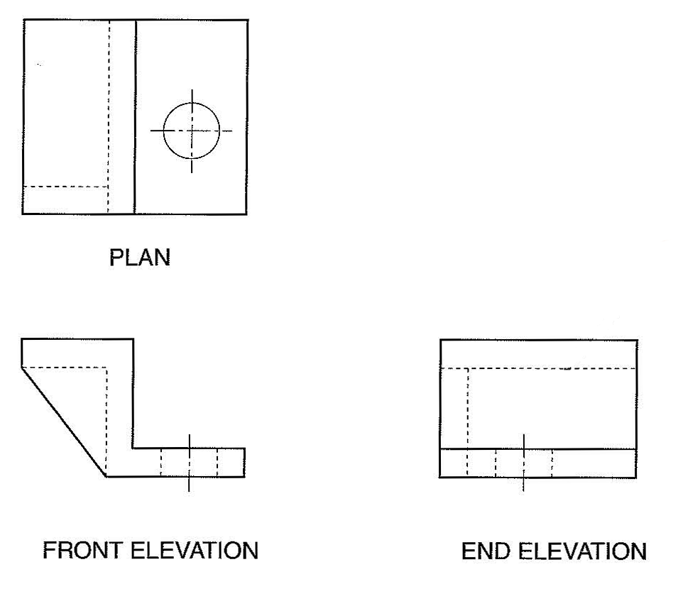
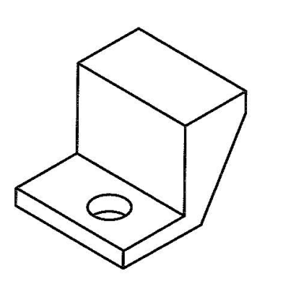
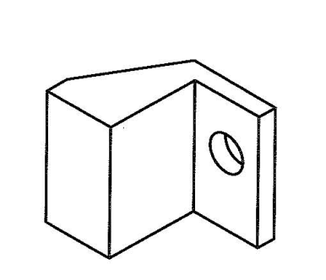
Q34 – KI Revision
10
9
8
7
6
5
4
3
2
1
0
Which pictorial drawing represents the given orthographic?
A.
B.
C.

Slide 39
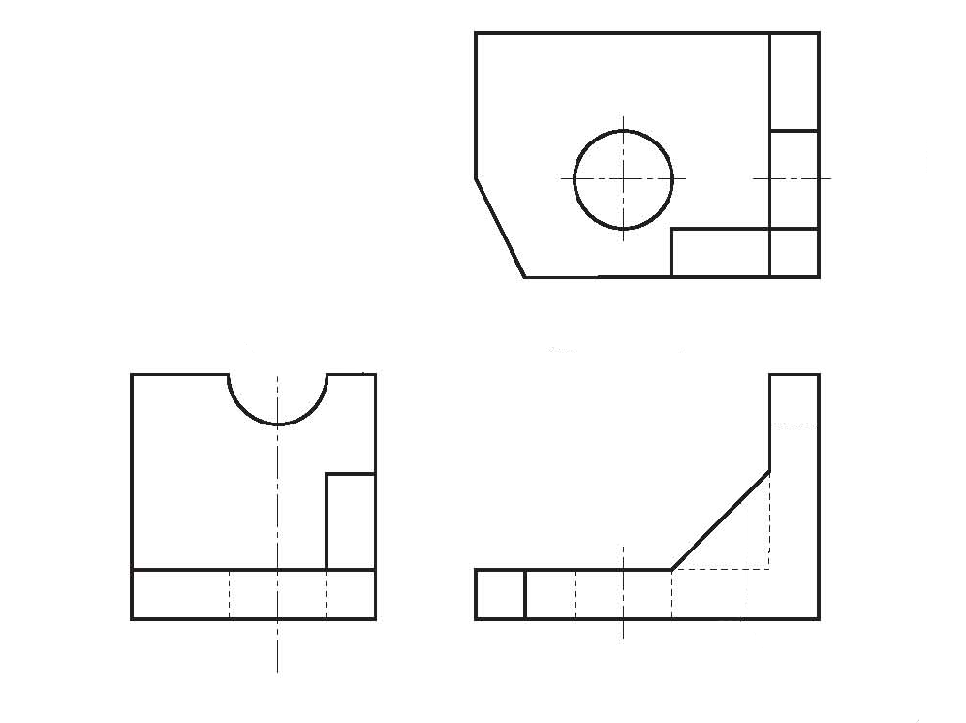
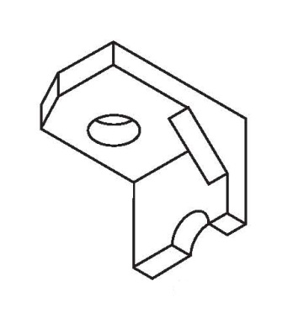
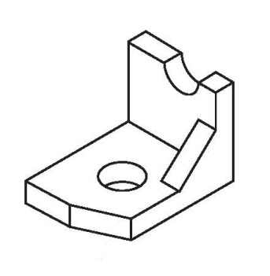
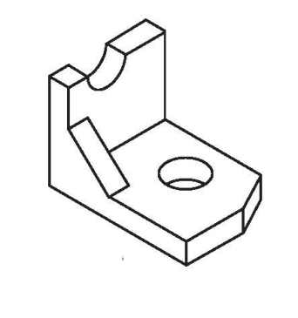
Q35 – KI Revision
10
9
8
7
6
5
4
3
2
1
0
Which pictorial drawing represents the given orthographic?
A.
Plan
B.
C.
End Elevation
Elevation

Slide 40
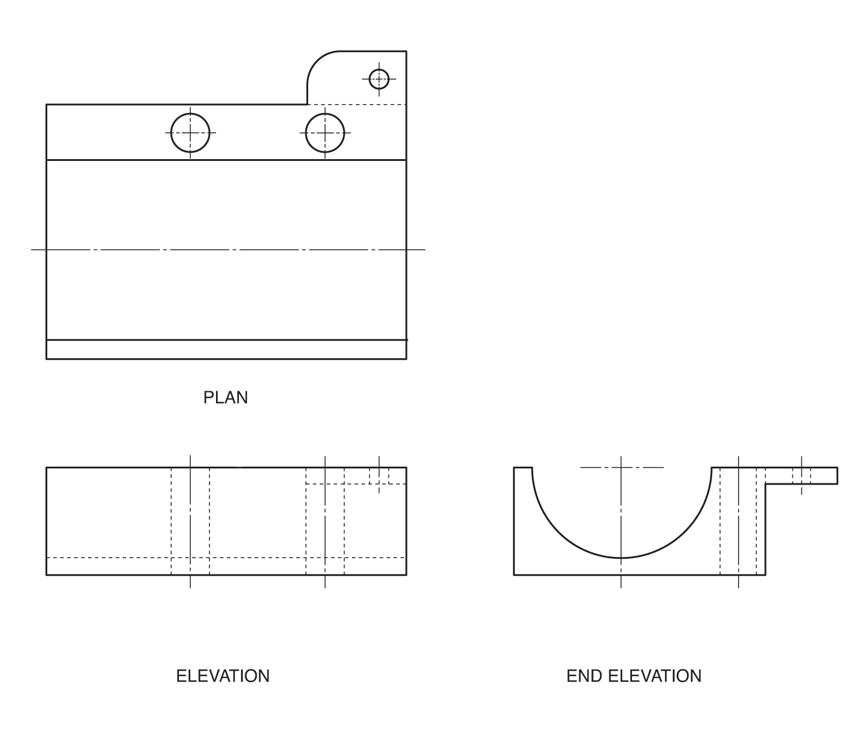
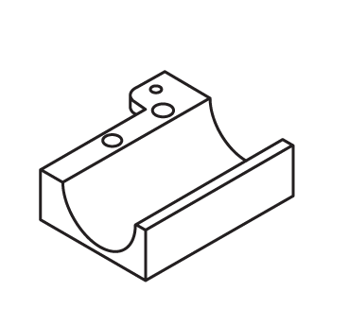
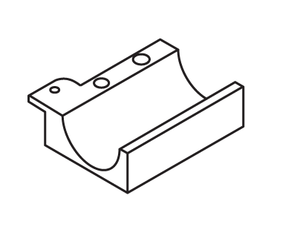
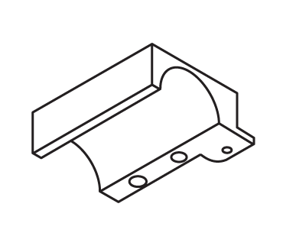
Q36 – KI Revision
10
9
8
7
6
5
4
3
2
1
0
Which pictorial drawing represents the given orthographic?
A.
B.
C.

Slide 41
Q38 – KI Revision
10
9
8
7
6
5
4
3
2
1
0
What is meant by the term library when using CAG?
A. A shelf of CAG textbooks.
B. A building where books are kept.
C. A collection of commonly used parts.

Slide 42
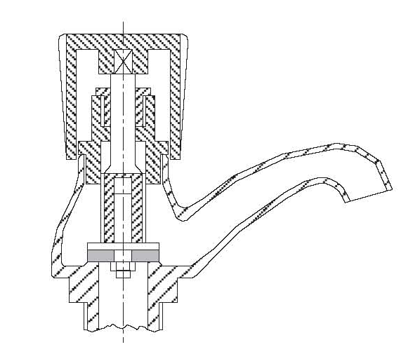

Q39 – KI Revision
10
9
8
7
6
5
4
3
2
1
0
What is The purpose of this type of drawing?
A. To confuse!!
B To clarify internal details.
C. To supply household water.

Slide 43
Q40 – KI Revision
10
9
8
7
6
5
4
3
2
1
0
Perform the following calculation using mental arithmetic?
Take 1000 and add 40.
Add 1000.
Add 30 and then add 1000.
Add 20.
Add 1000 and then add 10.
Write down your answer

Slide 44

The end

Slide 45
Solutions

Slide 46
Solutions
Q1 – KI Revision
What type of drawing is shown below?
Is it a:-
A. Isometric
B. Section
C. Plan

Slide 47
Solutions
Q2 – KI Revision
What type of line is this?
Line type?
Is it a:-
A. Outline
B. Hatch line
C. Hidden detail

Slide 48
Solutions
Q3 – KI Revision
What type of pictorial drawing is this?
45°
45°
A. Isometric
B. Oblique
C. Planometric

Slide 49
Solutions
Q4 – KI Revision
What type of drawing is this?
A. Isometric
B. development
C. Planometric

Slide 50
Solutions
Q5 – KI Revision
What type of line is this?
Line type?
A. Centre line
B. Fold line
C. Section line

Slide 51
Solutions
Q6 – KI Revision
What type of drawings are these?
A. Isometric
B. Planometric
C. 1 point perspective

Slide 52
Solutions
Q7 – KI Revision
What type of drawings is this?
A. Penometric
B. Inkometric
C. Exploded isometric

Slide 53
Q8 – KI Revision
Solutions
What type of drawing is this?
A. 2 point perspective
B. Isometric
C. 1 point perspective
30°
30°

Slide 54
Solutions
Q9 – KI Revision
What type of Line is this?
A. Fold line
B. Hidden detail Line
C. Centre line
Line type?

Slide 55
Solutions
Q10 – KI Revision
What type of drawing is this?
A. One point perspective
B. Oblique
C. Two point perspective

Slide 56
Solutions
Q11 – KI Revision
What do the letters VP stand for?
VP1
VP2
A. Very pretty
B. Vanishing point
C. Vertical plane

Slide 57
Solutions
Q12 – KI Revision
What is the name given to this line?
VP1
VP2
Name the Line?
A. Horizontal
B. Horizon
C. Horrible

Slide 58
Solutions
Q13 – KI Revision
What type of drawing is this?
A. Isometric
B. oblique
C. Planometric
45°

Slide 59
Solutions
Q14 – KI Revision
To make this type of drawing more visually appealing . What is done on the Z-axis ?
A. Double the sizes
Z axis
B. Halve the sizes
C. Guess the sizes

Slide 60
Solutions
Q15 – KI Revision
What type of line is this?
A. Hidden detail line
B. Fold line
A
Line type?
C. Section line
A

Slide 61
Solutions
Q16 – KI Revision
What type of Drawing is this?
A. Floor map
B. Floor plan
C. Floor mop

Slide 62
Solutions
Q17 – KI Revision
What type of Drawing is this?
A. Site plan
B. Smith Plan
C. Location plan

Slide 63
Solutions
Q18 – KI Revision
What type of Drawing is this?
A. Location plan
B. Floor Plan
C. Site plan

Slide 64
Solutions
Q19 – KI Revision
What does this symbol mean on a drawing?
A Millimetres
B. 1st angle projection
C. 3rd angle projection

Slide 65
Solutions
Q20 – KI Revision
What does this symbol mean on a Package?
A Bows and arrows ahead
B. Look up
C. This way up

Slide 66
Solutions
Q21 – KI Revision
What does this symbol mean on a package?
A Wine for sale
B. Glasses for sale
C. Fragile

Slide 67
Solutions
Q22 – KI Revision
What does this symbol mean on a Package?
A. Expect rain
B. Waterproof
C. Keep dry

Slide 68
Solutions
Q23 – KI Revision
What do these letters mean on a drawing?
AF
A Automatic Focus
B. Across the Flats
C. Almost Finished

Slide 69
Solutions
Q24 – KI Revision
What do these letters mean on a drawing?
AC
A Across the Corners
B. Alternating Current
C. Half a rock band

Slide 70
Solutions
Q25 – KI Revision
What does this symbol mean when it is put before a dimension on a drawing?
example
60
A Square
B. Squint
C. Box

Slide 71
Solutions
Q26 – KI Revision
What type of graph is this?
A Pie chart
B. Pictogram
C. Fruitogram

Slide 72
Solutions
Q27 – KI Revision
What type of graph is this?
Y-axis
25
20
15
10
5
Temperature °C
0
-5
-10
X-axis
Jan
Feb
Mar
Apr
May
Jun
Jul
Aug
Sep
Oct
Nov
Dec
TIME
A Crawl graph
B. Line Graph
C. Bar Graph

Slide 73
Solutions
Q28 – KI Revision
What type of graph is this?
A Pie chart
B. Pictogram
C. Bar Chart

Slide 74
Solutions
Q29 – KI Revision
What type of input device is this?
A Ink jet printer
B. Hand Scanner
C. Flat bed scanner

Slide 75
Solutions
Q30 – KI Revision
What type of input device is this?
A Flat bed plotter
B. Symbol blotter
C. Drum plotter

Slide 76
Solutions
Q31 – KI Revision
10
9
8
7
6
5
4
3
2
1
0
What type of devices can not produce images containing tones such as photographs?
A. Flat bed plotter
B. Ink jet printer
C. Laser Printer

Slide 77
Solutions
Q32 – KI Revision
What is the name given to this type of storage device?
A. Compact Disc
B. Hard drive
C. Flash drive

Slide 78
Solutions
Q33 – KI Revision
What is the name given to a device used to convert manual drawings to digital?
A. Sterilising tablet
B. Dishwasher tablet
C. Digitising tablet

Slide 79
Solutions
Q34 – KI Revision
Which pictorial drawing represents the given orthographic?
A.
B.
C.

Slide 80
Solutions
Q35 – KI Revision
Which pictorial drawing represents the given orthographic?
A.
Plan
B.
C.
End Elevation
Elevation

Slide 81
Solutions
Q36 – KI Revision
Which pictorial drawing represents the given orthographic?
A.
B.
C.

Slide 82
Solutions
Q38 – KI Revision
What is meant by the term library when using CAG?
A. A shelf of CAG textbooks.
B. A building where books are kept.
C. A collection of commonly used parts.

Slide 83
Solutions
Q39 – KI Revision
What is The purpose of this type of drawing?
A. To confuse!!
B To clarify internal details.
C. To supply household water.

Slide 84
Solutions
Q40 – KI Revision
Perform the following calculation using mental arithmetic?
Take 1000 and add 40.
Add 1000.
Add 30 and then add 1000.
Add 20.
Add 1000 and then add 10.
Write down your answer

Slide 85
Solutions
Q40 – KI Revision
Perform the following calculation using mental arithmetic?
5000
Is incorrect
Write down your answer

Slide 86
Solutions
Q40 – KI Revision
Perform the following calculation using mental arithmetic?
1000
40
1000
30
1000
20
1000
10
Take 1000 and add 40.
Add 1000.
Add 30 and then add 1000.
Add 20.
Add 1000 and then add 10.
4100
4100
Write down your answer

Slide 87
Cleary mark out of 40
Return the answer sheets

