Slide 1
Graphics KI revision
Quiz 1

Slide 2
41 Multiple choice Questions
10 seconds per question
1 Mark Each

Slide 3
Write down the correct letter
and
write down the correct answer or symbol

Slide 4
Q1 – KI Revision
10
9
8
7
6
5
4
3
2
1
0
Which of the following colours is a primary colour?
A. Green
B. Red
C. Purple

Slide 5
Q2 – KI Revision
10
9
8
7
6
5
4
3
2
1
0
When you add white to a colour you produce which of the following?
A. Shade
B. Emulsion
C. Tint

Slide 6
Q3 – KI Revision
10
9
8
7
6
5
4
3
2
1
0
When you use colours together that are opposite on the colour wheel they are said to be?
Yellow-
green
Yellow
Yellow-orange
A. Constant colours
Green
Orange
Blue-
green
Red-
orange
B. Contrasting colours
Blue
Red
C. Harmonising colours
Blue-
violet
Red-
violet
Violet

Slide 7
Q4 – KI Revision
10
9
8
7
6
5
4
3
2
1
0
Secondary colours are produced when you mix:-
A. Red and purple
B. Two primary colours
C. A primary colour and black

Slide 8
Q5 – KI Revision
10
9
8
7
6
5
4
3
2
1
0
Adding black to a colour produces a :-
A. A shadow
B. A Shade
C. A tonal scale

Slide 9
Q6 – KI Revision
10
9
8
7
6
5
4
3
2
1
0
Warm colours such as red and orange are said to be:-
A. Advantageous
B. Advancing
C. Receding

Slide 10
Q7 – KI Revision
10
9
8
7
6
5
4
3
2
1
0
Which of the following are considered to be a cool colour.:-
A. Yellow
B. Blue
C. Red

Slide 11
Q8 – KI Revision
10
9
8
7
6
5
4
3
2
1
0
Cool colours are said to:-
Yellow-
green
A. recede
Green
B. Advance
C. Contract
Blue-
green
Blue
Blue-
violet
Violet

Slide 12
Q9 – KI Revision
10
9
8
7
6
5
4
3
2
1
0
A tertiary colour is produced when:-
A. Black is added to a colour.
B. White is added to a colour.
C. A primary and secondary colour are
mixed together.

Slide 13
Q10 – KI Revision
10
9
8
7
6
5
4
3
2
1
0
Which of the following is a secondary colour.
A. Yellow
B. Green
C. Yellow - orange

Slide 14
Q11 – KI Revision
10
9
8
7
6
5
4
3
2
1
0
What does the following symbol on an orthographic drawing mean?
A. No entry
B. Radius
C. Diameter

Slide 15
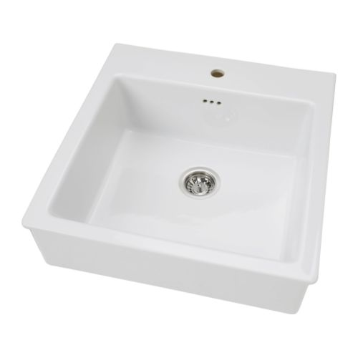
Q12 – KI Revision
10
9
8
7
6
5
4
3
2
1
0
What is the correct architectural symbol for a sink? Is it
A.
B.
C.

Slide 16

Q13 – KI Revision
10
9
8
7
6
5
4
3
2
1
0
What is the correct architectural symbol for a radiator? Is it
A.
B.
C.

Slide 17
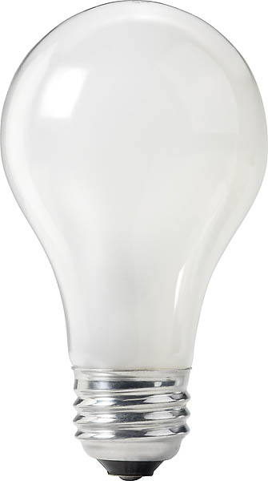
Q14 – KI Revision
10
9
8
7
6
5
4
3
2
1
0
What is the correct architectural symbol for a Lamp? Is it
A.
B.
C.

Slide 18
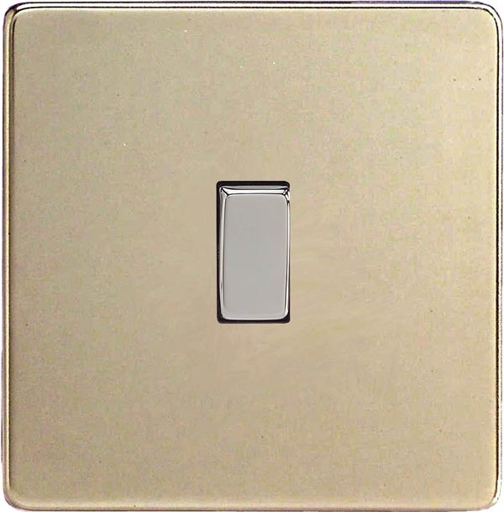
Q15 – KI Revision
10
9
8
7
6
5
4
3
2
1
0
What is the correct architectural symbol for a switch? Is it
A.
B.
C.

Slide 19

Q16 – KI Revision
10
9
8
7
6
5
4
3
2
1
0
What is the correct architectural symbol for a window? Is it
A.
B.
C.

Slide 20
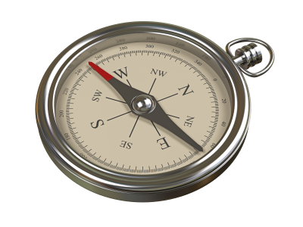
Q17 – KI Revision
10
9
8
7
6
5
4
3
2
1
0
What is the correct architectural symbol used to indicate north? Is it
A.
B.
C.

Slide 21
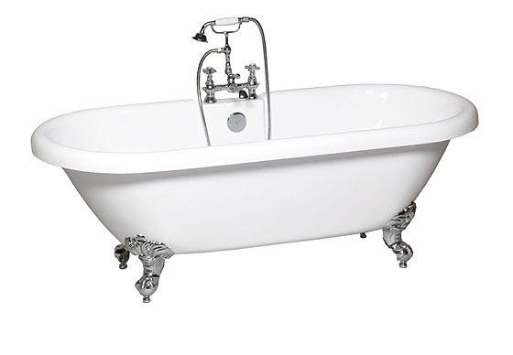
Q18 – KI Revision
10
9
8
7
6
5
4
3
2
1
0
What is the correct architectural symbol for a bath? Is it
A.
B.
C.

Slide 22
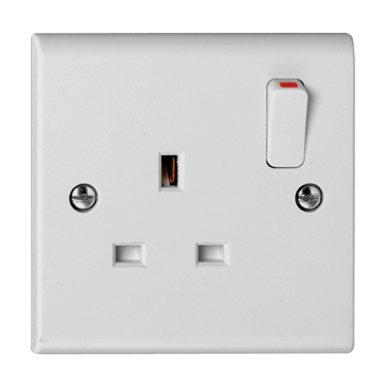
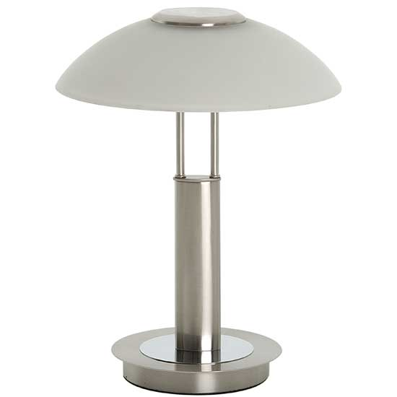

Q19 – KI Revision
10
9
8
7
6
5
4
3
2
1
0
What does this architectural symbol show.
A.
A Socket
B.
A lamp
C.
A tap

Slide 23
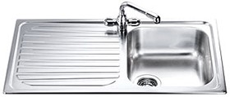
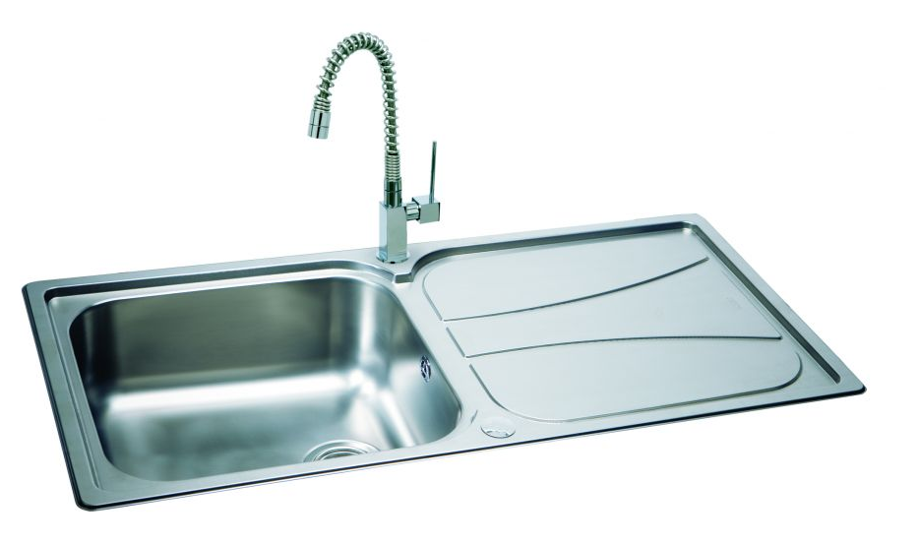

Q20 – KI Revision
10
9
8
7
6
5
4
3
2
1
0
What does this architectural symbol show.
A.
Sink with L/H Drainer.
B.
C.
Shower tray.
Sink with R/H Drainer.

Slide 24
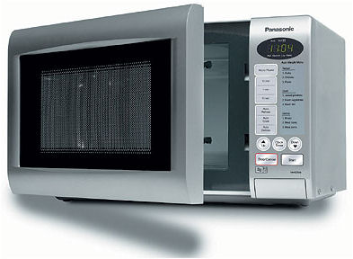
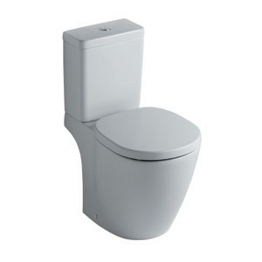
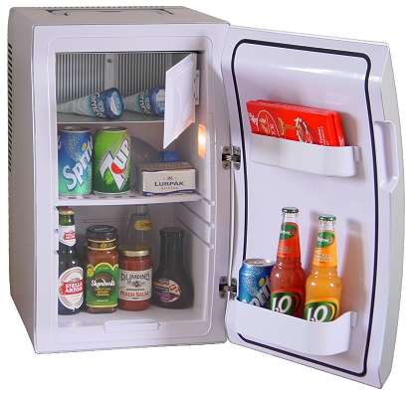
Q21 – KI Revision
10
9
8
7
6
5
4
3
2
1
0
What does this architectural symbol show.
A.
B.
C.

Slide 25
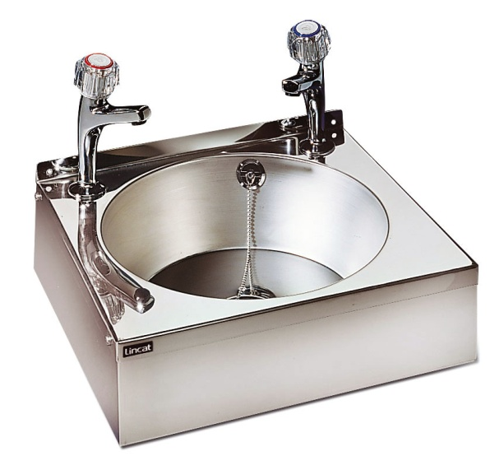
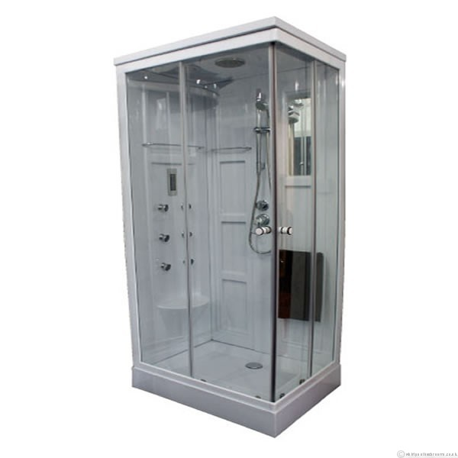
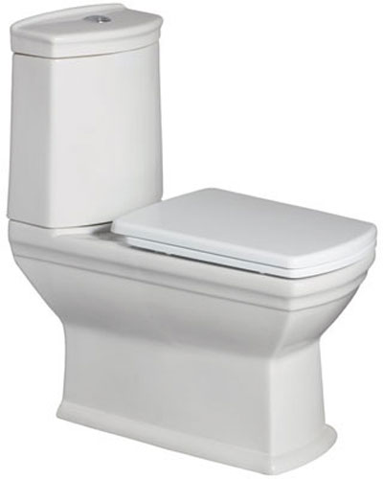
Q21 – KI Revision
10
9
8
7
6
5
4
3
2
1
0
Q21
What does this architectural symbol show.
A.
C.
B.

Slide 26
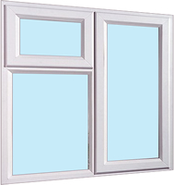

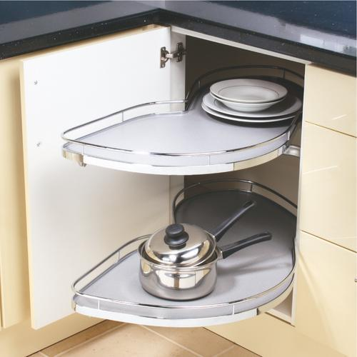
Q23 – KI Revision
10
9
8
7
6
5
4
3
2
1
0
What does this architectural symbol show.
A.
B.
C.

Slide 27
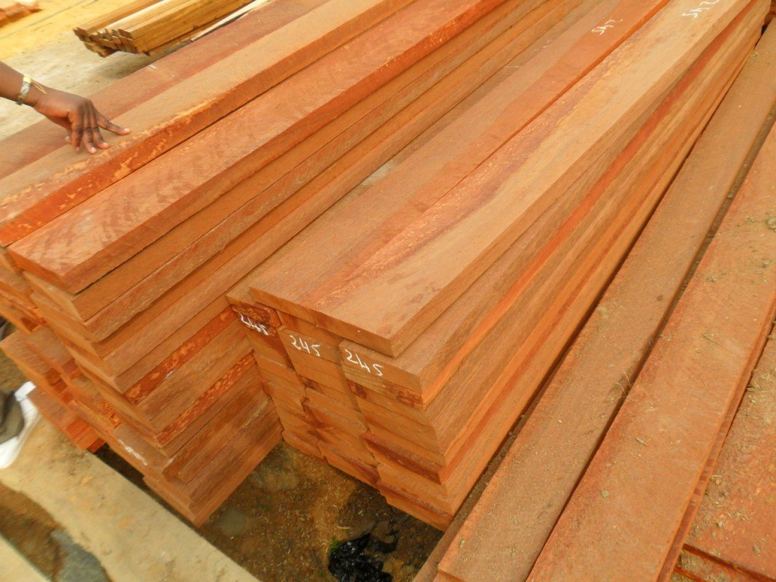

Q24 – KI Revision
10
9
8
7
6
5
4
3
2
1
0
What is the architectural symbol for sawn wood. Is it:-
A.
B.
C.

Slide 28
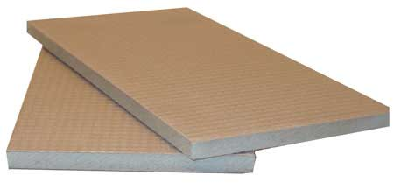
Q25 – KI Revision
10
9
8
7
6
5
4
3
2
1
0
What is the architectural symbol for insulating board. Is it
A.
B.
C.

Slide 29
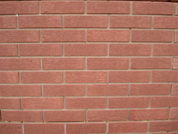
Q26 – KI Revision
10
9
8
7
6
5
4
3
2
1
0
What is the architectural symbol for brickwork. Is it:-
A.
B.
C.

Slide 30


Q27 – KI Revision
10
9
8
7
6
5
4
3
2
1
0
What is the architectural symbol for Concrete. Is it:-
A.
B.
C.

Slide 31
Q28 – KI Revision
10
9
8
7
6
5
4
3
2
1
0
What Type of sign is this.
Is it:-
A.
A warning sign
B.
A Mandatory sign
C.
A Prohibition sign

Slide 32

Q29 – KI Revision
10
9
8
7
6
5
4
3
2
1
0
What Type of sign is this.
Is it:-
A.
A warning sign
B.
A Mandatory sign
C.
A Prohibition sign

Slide 33
Q30 – KI Revision
10
9
8
7
6
5
4
3
2
1
0
This prohibition sign is incorrectly coloured. The border and stripe should be
A.
Blue
B.
Green
C.
Red

Slide 34

Q31 – KI Revision
10
9
8
7
6
5
4
3
2
1
0
What is this sign?
A.
Superman symbol
B.
BSI Kitemark
C.
Safety sign

Slide 35

Q32 – KI Revision
10
9
8
7
6
5
4
3
2
1
0
What does CAG stand for?
A.
Computer And Graphics
B.
Computer Aided Graphics
C.
Computer Aided Generator

Slide 36

Q33 – KI Revision
10
9
8
7
6
5
4
3
2
1
0
What does DTP stand for?
A.
Draw The Plan
B.
Desk Top Photocopier
C.
Desk Top Publisher

Slide 37
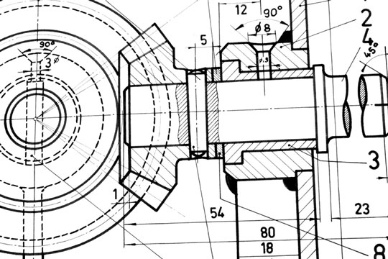
Q34 – KI Revision
10
9
8
7
6
5
4
3
2
1
0
What CAD software have you used in Dingwall Academy?
A.
Autosketch
B.
Adobe Illustrator
C.
Microsoft Word

Slide 38
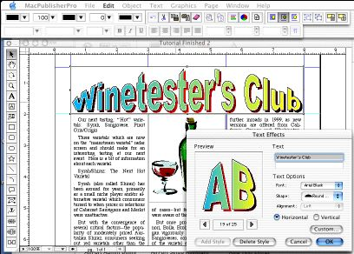
Q35 – KI Revision
10
9
8
7
6
5
4
3
2
1
0
What DTP software have you used in Dingwall Academy?
A.
Adobe Illustrator
B.
Microsoft Publisher
C.
Microsoft Word

Slide 39
Q36 – KI Revision
10
9
8
7
6
5
4
3
2
1
0
What Cad command forces a line horizontal, vertical or at a predefined angle?
A.
Attach
B.
Ortho
C.
Break

Slide 40

Q37 – KI Revision
10
9
8
7
6
5
4
3
2
1
0
What Cad command forces a line to connect accurately to another line in a specific way.
On/off
A.
Attach
B.
Ortho
C.
Break

Slide 41
Q38 – KI Revision
10
9
8
7
6
5
4
3
2
1
0
What Cad command forces a line to connect accurately to another line as shown.
A.
Attach
B.
Trim
C.
Extend

Slide 42
Q39 – KI Revision
10
9
8
7
6
5
4
3
2
1
0
What Cad command will change drawing A to Drawing B.
A.
Chamfer
A
B
B.
Fillet
C.
Ring array

Slide 43
Q40 – KI Revision
10
9
8
7
6
5
4
3
2
1
0
What single Cad command will change drawing A to Drawing B.
A.
Mirror
B.
Copy
A
B
C.
Multicopy

Slide 44
Q41 – KI Revision
10
9
8
7
6
5
4
3
2
1
0
What single Cad command will change the drawings as shown.
OR
A.
Copy
B.
Rotate
C.
Mirror

Slide 45
Solutions

Slide 46
Q1 – KI Revision Solutions
Which of the following colours is a primary colour?
A. Green
B. Red
C. Purple

Slide 47
Q2 – KI Revision Solutions
When you add white to a colour you produce which of the following?
A. Shade
B. Emulsion
C. Tint

Slide 48
Q3 – KI Revision Solutions
When you use colours together that are opposite on the colour wheel they are said to be?
Yellow-
green
Yellow
Yellow-orange
A. Constant colours
Green
Orange
Blue-
green
Red-
orange
B. Contrasting colours
Blue
Red
C. Harmonising colours
Blue-
violet
Red-
violet
Violet

Slide 49
Q4 – KI Revision Solutions
Secondary colours are produced when you mix:-
A. Red and purple
B. Two primary colours
C. A primary colour and black

Slide 50
Q5 – KI Revision Solutions
Adding black to a colour produces a :-
A. A shadow
B. A Shade
C. A tonal scale

Slide 51
Q6 – KI Revision Solutions
Warm colours such as red and orange are said to be:-
A. Advantageous
B. Advancing
C. Receding

Slide 52
Q7 – KI Revision Solutions
Which of the following are considered to be a cool colour.:-
A. Yellow
B. Blue
C. Red

Slide 53
Q8 – KI Revision Solutions
Cool colours are said to:-
Yellow-
green
A. recede
Green
B. Advance
C. Contract
Blue-
green
Blue
Blue-
violet
Violet

Slide 54
Q9 – KI Revision Solutions
A tertiary colour is produced when:-
A. Black is added to a colour.
B. White is added to a colour.
C. A primary and secondary colour are
mixed together.

Slide 55
Q10 – KI Revision Solutions
Which of the following is a secondary colour.
A. Yellow
B. Green
C. Yellow - orange

Slide 56
Q11 – KI Revision Solutions
What does the following symbol on an orthographic drawing mean?
A. No entry
B. Radius
C. Diameter

Slide 57
Q12 – KI Revision Solutions
What is the correct architectural symbol for a sink? Is it
A.
B.
C.

Slide 58
Q13 – KI Revision Solutions
What is the correct architectural symbol for a radiator? Is it
A.
B.
C.

Slide 59
Q14 – KI Revision Solutions
What is the correct architectural symbol for a Lamp? Is it
A.
B.
C.

Slide 60
Q15 – KI Revision Solutions
What is the correct architectural symbol for a switch? Is it
A.
B.
C.

Slide 61
Q16 – KI Revision Solutions
What is the correct architectural symbol for a window? Is it
A.
B.
C.

Slide 62
Q17 – KI Revision Solutions
What is the correct architectural symbol used to indicate north? Is it
A.
B.
C.

Slide 63
Q18 – KI Revision Solutions
What is the correct architectural symbol for a bath? Is it
A.
B.
C.

Slide 64
Q19 – KI Revision Solutions
What does this architectural symbol show.
A.
A Socket
B.
A lamp
C.
A tap

Slide 65
Q20 – KI Revision Solutions
What does this architectural symbol show.
A.
Sink with L/H Drainer.
B.
C.
Shower tray.
Sink with R/H Drainer.

Slide 66
Q21 – KI Revision Solutions
What does this architectural symbol show.
A.
B.
C.

Slide 67
Q21 – KI Revision Solutions
Q21
What does this architectural symbol show.
A.
C.
B.

Slide 68
Q23 – KI Revision Solutions
What does this architectural symbol show.
A.
B.
C.

Slide 69
Q24 – KI Revision Solutions
What is the architectural symbol for sawn wood. Is it:-
A.
B.
C.

Slide 70
Q25 – KI Revision Solutions
What is the architectural symbol for insulating board. Is it
A.
B.
C.

Slide 71
Q26 – KI Revision Solutions
What is the architectural symbol for brickwork. Is it:-
A.
B.
C.

Slide 72
Q27 – KI Revision Solutions
What is the architectural symbol for Concrete. Is it:-
A.
B.
C.

Slide 73
Q28 – KI Revision Solutions
What Type of sign is this.
Is it:-
A.
A warning sign
B.
A Mandatory sign
C.
A Prohibition sign

Slide 74
Q29 – KI Revision Solutions
What Type of sign is this.
Is it:-
A.
A warning sign
B.
A Mandatory sign
C.
A Prohibition sign

Slide 75
Q30 – KI Revision Solutions
This prohibition sign is incorrectly coloured. The border and stripe should be
A.
Blue
B.
Green
C.
Red

Slide 76
Q31 – KI Revision Solutions
What is this sign?
A.
Superman symbol
B.
BSI Kitemark
C.
Safety sign

Slide 77
Q32 – KI Revision Solutions
What does CAG stand for?
A.
Computer And Graphics
B.
Computer Aided Graphics
C.
Computer Aided Generator

Slide 78
Q33 – KI Revision Solutions
What does DTP stand for?
A.
Draw The Plan
B.
Desk Top Photocopier
C.
Desk Top Publisher

Slide 79
Q34 – KI Revision Solutions
What CAD software have you used in Dingwall Academy?
A.
Autosketch
B.
Adobe Illustrator
C.
Microsoft Word

Slide 80
Q35 – KI Revision Solutions
What DTP software have you used in Dingwall Academy?
A.
Adobe Illustrator
B.
Microsoft Publisher
C.
Microsoft Word

Slide 81
Q36 – KI Revision Solutions
What Cad command forces a line horizontal, vertical or at a predefined angle?
A.
Attach
B.
Ortho
C.
Break

Slide 82
Q37 – KI Revision Solutions
What Cad command forces a line to connect accurately to another line in a specific way.
On/off
A.
Attach
B.
Ortho
C.
Break

Slide 83
Q38 – KI Revision Solutions
What Cad command forces a line to connect accurately to another line as shown.
A.
Attach
B.
Trim
C.
Extend

Slide 84
Q39 – KI Revision Solutions
What Cad command will change drawing A to Drawing B.
A.
Chamfer
A
B
B.
Fillet
C.
Ring array

Slide 85
Q40 – KI Revision Solutions
What single Cad command will change drawing A to Drawing B.
A.
Mirror
B.
Copy
A
B
C.
Multicopy

Slide 86
Q41 – KI Revision Solutions
What single Cad command will change drawing A to Drawing B.
OR
A.
Copy
B.
Rotate
C.
Mirror

Slide 87

The end

Slide 88
Cleary mark out of 41
Return the answer sheets

