Slide 1
SG graphic communication – General KI – 2009 Q1
Index
9
1.
Floor plan
Sink with Drainer
Socket
Switch
Lamp/Bulb
Washbasin
Shower tray
(scale normally 1:50)
Location plan or Block plan
1: 1250
(scale normally 1:1250)
North symbol or North point
Site plan
(scale normally 1:200)

Slide 2
SG graphic communication – General KI – 2009 Q2
Index
9
2.
Black
Floor plan
Yellow
SAFETY
FIRST
Green
Prohibition
Red
White
Mandatory

Slide 3
SG graphic communication – General KI – 2009 Q2
Index
9
2.
CAD – Computer Aided Drawing
Box array
Fillet
Rotate
Hatch/ Pattern fill
Ellipse
Circle

Slide 4
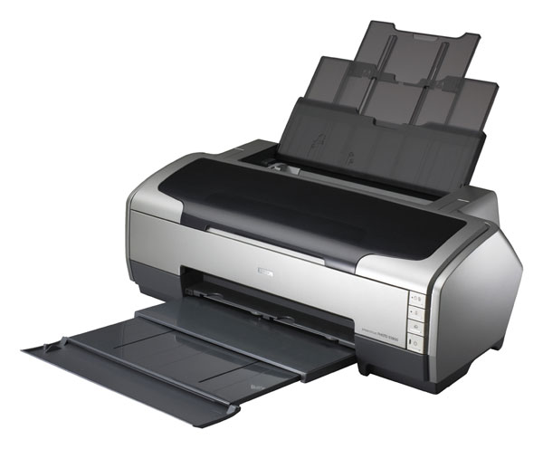
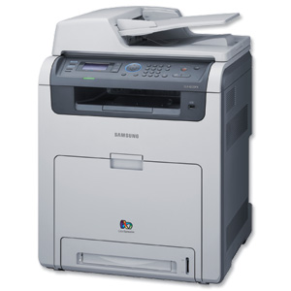
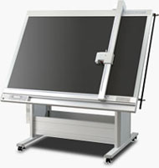
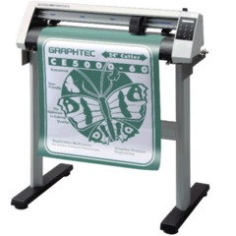
SG graphic communication – General KI – 2008 Q3
Index
09
3.
Ink jet printer, Laser printer
Flat bed plotter or Drum plotter
To make an extra copy of data or files, stored on a
separate device.
In case the data or files get lost, deleted or corrupted.
Ink Jet Printer
Laser Printer
Flatbed plotter
Drum plotter

Slide 5
SG graphic communication – General KI – 2009 Q4
Index
09
4.
Oblique
Isometric
Planometric
One point perspective
Two point perspective
45°
Pictorial

Slide 6
SG graphic communication – General KI – 2010 Q1
Index
10
1.
Line
Fillet or Arc
Arc
Chamfer
Circle
Text
Break
Copy
Ring Array
Scale or Zoom

Slide 7
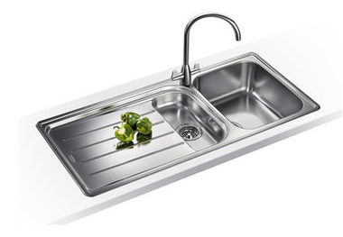
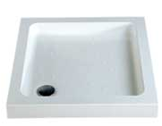
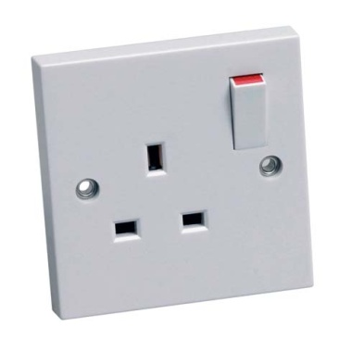
SG graphic communication – General KI – 2010 Q2
Index
10
2.
Sink with LH drainer
Switch
Socket
Lamp or Bulb
Brickwork
Shower tray
Wash basin
Bath

Slide 8
SG graphic communication – General KI – 2010 Q3
Index
10
3.
Isometric
Oblique
Planometric
Bath
Horizon or Eye level
Vanishin points
60°
30°

Slide 9
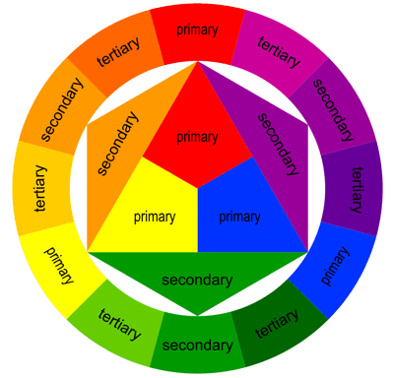
SG graphic communication – General KI – 2010 Q4
Index
10
4.
Black
White
Blue/Green/Violet
Blue-Violet/Blue-Green
Secondary colour
Yellow / Orange
Blue/Green/Violet/Blue-Violet/Blue-Green
Green / Brown
Red

Slide 10
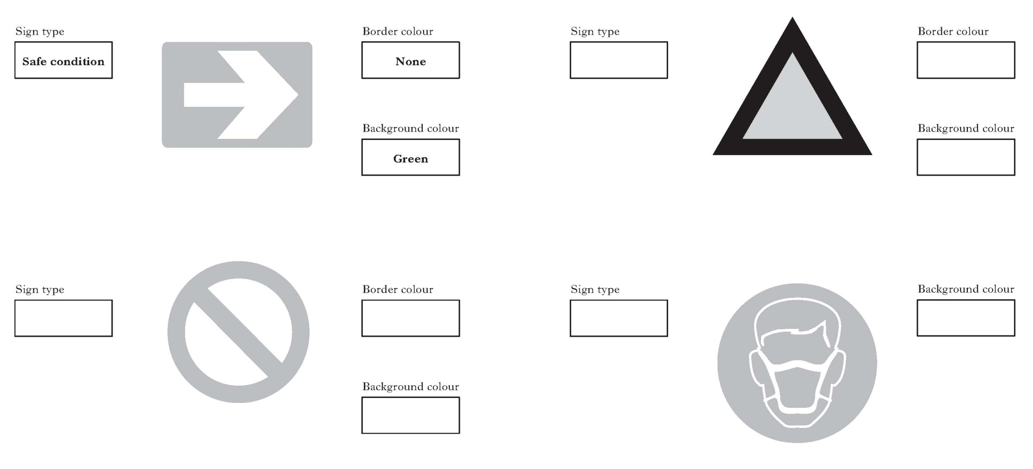
SG graphic communication – General KI – 2011 Q1
Index
10
1.
Warning
Black
Yellow
Prohibition
Red
Mandatory
Blue
White

Slide 11
SG graphic communication – General KI – 2011 Q2
Index
10
2.
Orange
Red
Green
Blue, Blue-Violet, Violet, Red-Violet, Red (Purple)
Violet, Red-Violet, Red-Orange, Orange
To give prominence to the subject of the presentation
A secondary colour
Red-Violet
Red-Orange

Slide 12
SG graphic communication – General KI – 2011 Q3
Index
10
3.
Oblique
Isometric
1 point perspective
2 point perspective
Pictorial
45°
Vanishing point
Horizon or eye level

Slide 13
SG graphic communication – General KI – 2011 Q4
Index
10
4.
Shower tray
Wash basin
Sink with drainer
North symbol
W/C
Bath
Brickwork

Slide 14
SG graphic communication – General KI – 2011 Q4 cont
Index
10
4.
Floor plan
Site plan
Location or Block plan
(scale normally 1:1250)
(scale normally 1:50)
(scale normally 1:200)

