Slide 1
SG graphic communication – General KI – 2005 Q1
Index
1.
Drawings are more accurate, easier to edit, standardisation of formats, use of libraries of commonly used parts, reduction of lead time. Ability to e-mail.
Work can be lost if the computer crashes, work could be corrupted by viruses, obsolescence, work could be stolen or ‘hacked’, time taken to learn to use system, cost of software, training.
Zip drives, memory stick/flash drive, CD ROM, mobile hard drive, DVD, USB storage, CD
CAD library, symbol library
Ink-jet printer,
laser printer, printer

Slide 2
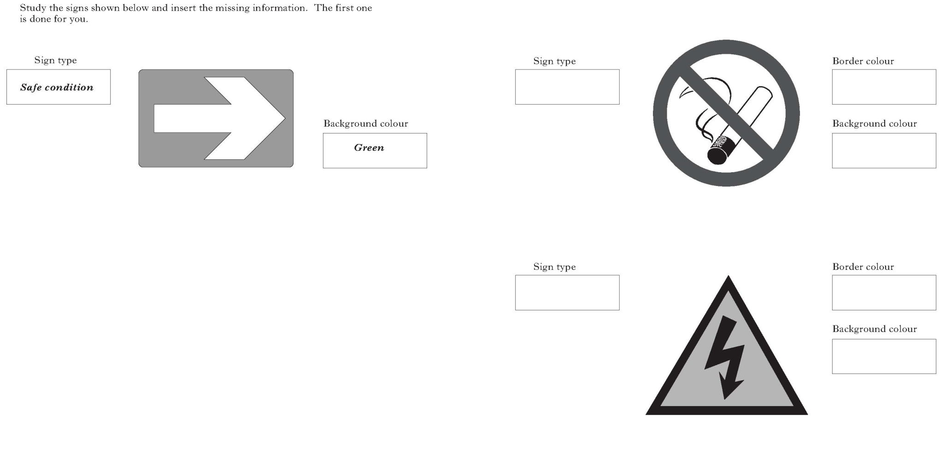
SG graphic communication – General KI – 2005 Q2
Index
2.
Prohibition
Red
White
Warning
Black
Yellow

Slide 3
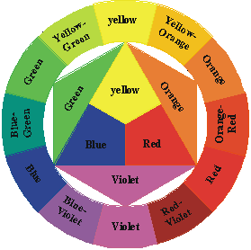
SG graphic communication – General KI – 2005 Q3
Index
3.
Green or brown
Blue or any cool colour, violet/green/white
Red
Yellow/Yellow-Orange/Orange/Red-Orange/Red
Green/Blue-Green/Blue-Violet/Violet
Makes the subject of the presentation more prominent/or to stand out/objects look bigger/gives depth.
Black
White
Secondary colour
Red-Orange Red-Violet

Slide 4
SG graphic communication – General KI – 2005 Q4
Index
4.
Green or brown
Site plan (scale normally 1:200)
Location or block plan (scale normally 1:1250)
Floor plan (scale normally 1:50)
Shower tray
Wash basin
Sink with LH drainer
Brickwork
North symbol or North pont
Sawn wood – any type
Insulation

Slide 5
SG graphic communication – General KI – 2006 Q1
Index
1.
2
4
Isometric

Slide 6
SG graphic communication – General KI – 2006 Q2
Index
2.
One point perspective
Planometric
Oblique
Two point perspective
45°
30 °
60 °

Slide 7
SG graphic communication – General KI – 2006 Q3
Index
3.
Hatch or pattern fill
Text
Line
Rectangle
Fillet
Circle
Chamfer
Scale or Zoom
Dimension
Copy or Multicopy
Mirror

Slide 8
SG graphic communication – General KI – 2006 Q4
Index
4.
Site plan
Location or Block plan
Floor plan
Hatch or pattern fill
Insulation
Sawn wood – any type
North symbol
Brickwork
Site plan (scale normally 1:50)
Socket
Lamp or Bulb
Switch
Location plan(scale normally 1:1250)
Floor Plan(scale normally 1:200)

