Slide 1
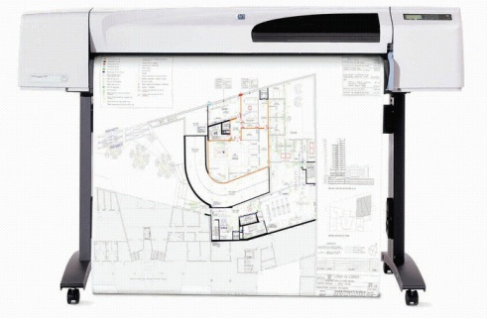
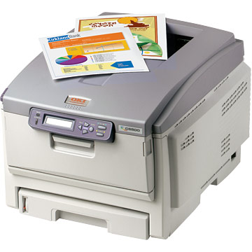
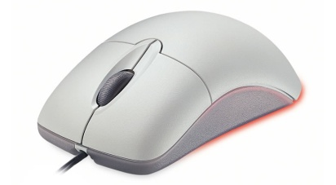
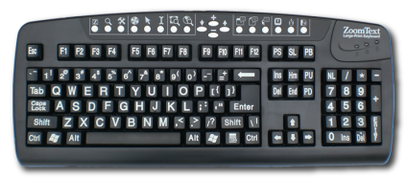
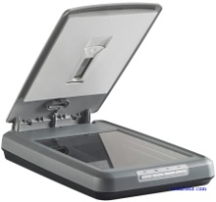
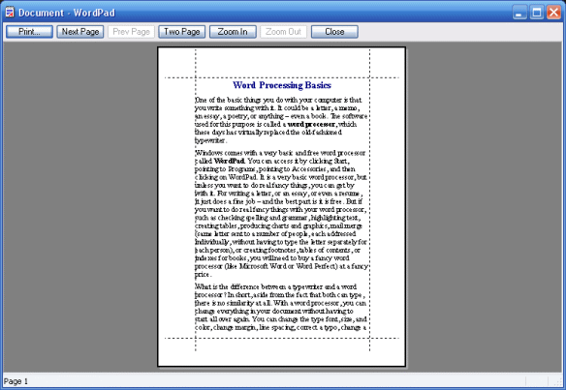
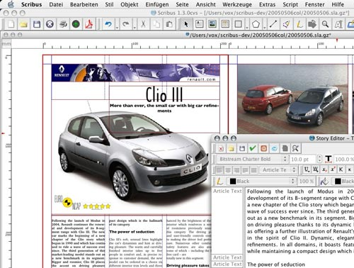
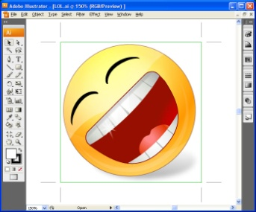
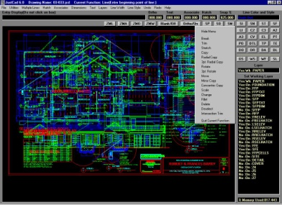
Standard Grade Graphic Communication KI 2011 Q1
Controlling the curser and inputting commands.
Outputting Hard copies with colour, lines and tones
Outputting hard copies of line drawings.
Inputting text and numbers.
Copying images into the computer memory.
Word processing
CAD (Computer Aided Drawing)
Word processing
DTP – Desk Top Publishing
Illustration/paint
DTP (Desk Top Publishing)
Illustration/Paint
CAD – Computer Aided Drawing

Slide 2
Standard Grade Graphic Communication KI 2011 Q2
Green, Yellow-Green
Yellow-Orange, Orange

Slide 3
Standard Grade Graphic Communication KI 2011 Q3
To ensure that you do not lose your work if the computer crashes or freezes.

Slide 4
Standard Grade Graphic Communication KI 2011 Q4
2
4
5
1
3

