Slide 1
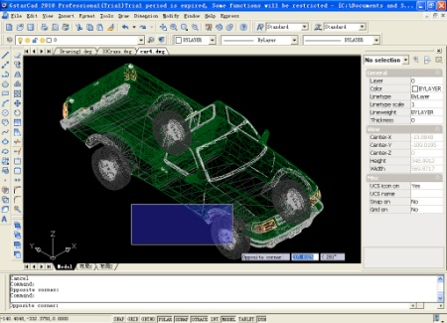
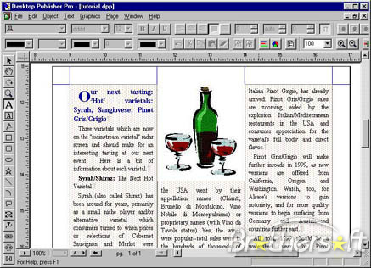
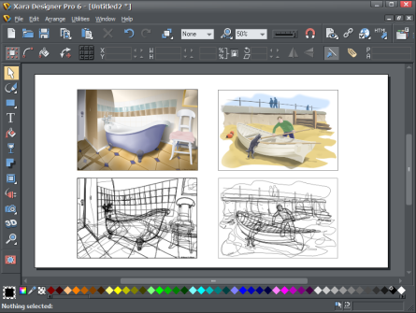
Standard Grade Graphic Communication KI 2009 Q1
CAD – Computer Aided Drawing
DTP – Desk Top Publishing
Illustration/paint
2-D CAD
DTP
Illustration/Paint

Slide 2
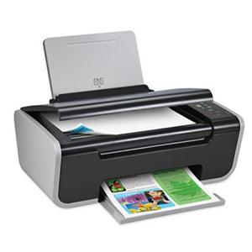
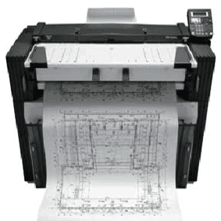
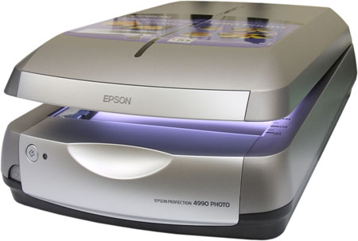
Standard Grade Graphic Communication KI 2009 Q1cont.
Plotter/ Inkjet printer
Keyboard
Scanner

Slide 3
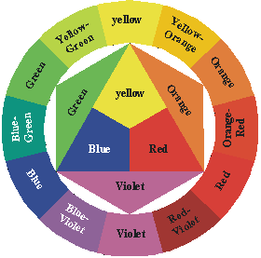
Standard Grade Graphic Communication KI 2009 Q2
Blue-Green, Green, Violet, Blue-Violet
Yellow, Yellow-Orange, Orange, Red-Orange, Red
White

Slide 4
Standard Grade Graphic Communication KI 2009 Q3

Slide 5
Standard Grade Graphic Communication KI 2009 Q4
Hidden Detail
Hatching
Outline
Cutting plane
Dimension
(Section X-X)
Outline
Hidden
Cutting Plane
Hatching
Dimension
30°
30°
Isometric
Oblique, 1 pt Perspective, 2 pt Perspective or Planometric

Slide 6
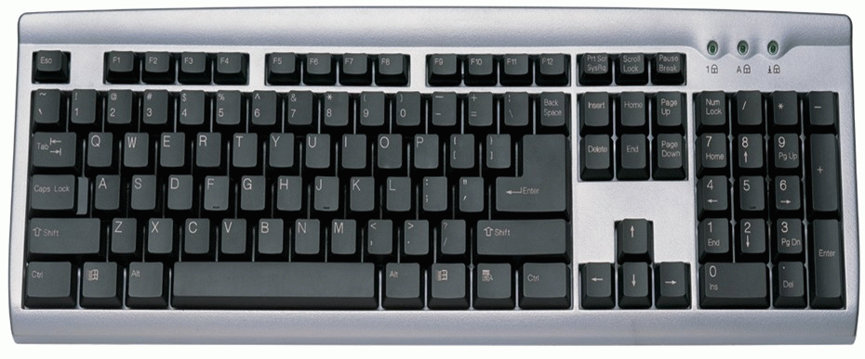
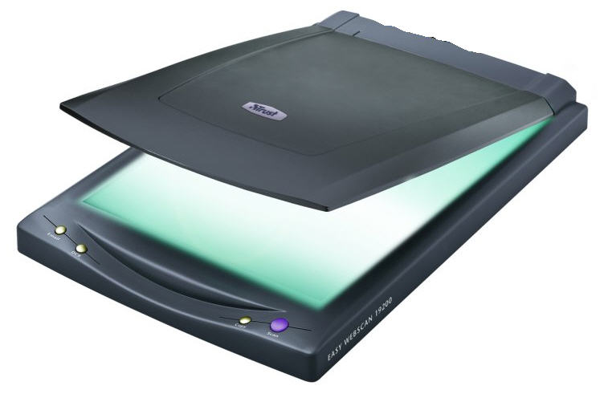
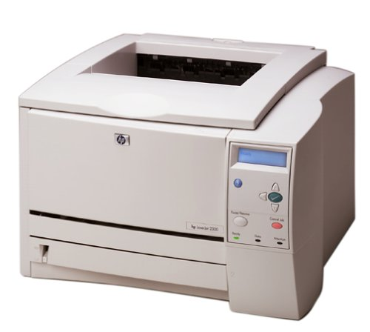
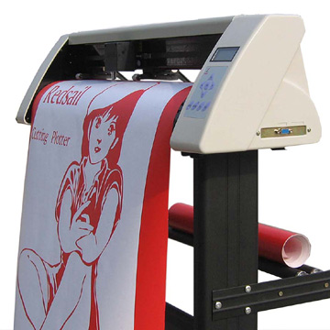
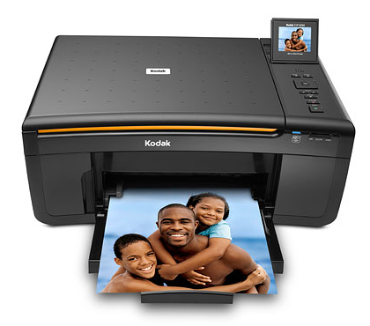
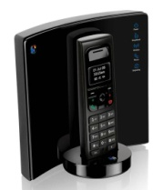
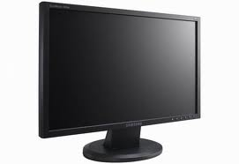
Standard Grade Graphic Communication KI 2010 Q1
Keyboard
Scanner
Printer or Plotter
Mouse
Printer
DTP Desk Top Publishing – Text and graphics
Modem
Monitor

Slide 7
Standard Grade Graphic Communication KI 2010 Q2
Orthographic
Outline
Hidden
Cutting Plane
Centre line
45°
Hatching
Section or Sectional end elevation
45°

Slide 8
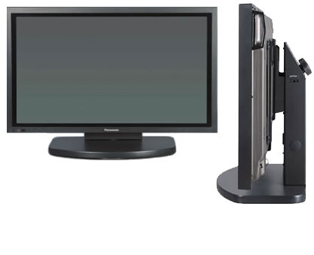
Standard Grade Graphic Communication KI 2010 Q3
Bar Chart
December
One (May)
December
November
Four( Jan, Feb, Aug and Sep)

Slide 9
Standard Grade Graphic Communication KI 2010 Q4

