Slide 1
Standard Grade Graphic Communication KI 2007 Q1
A paper copy or printout
In case the computer crashes/so that all data is not lost if you
accidentally delete your work.

Slide 2
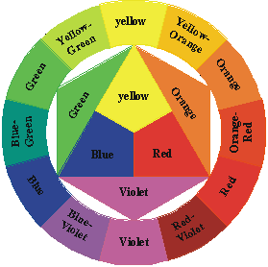
Standard Grade Graphic Communication KI 2007 Q2
Green, Yellow-Green
Yellow-Orange, Orange
Blue, Blue-Violet
Violet, Red-Violet, Red

Slide 3
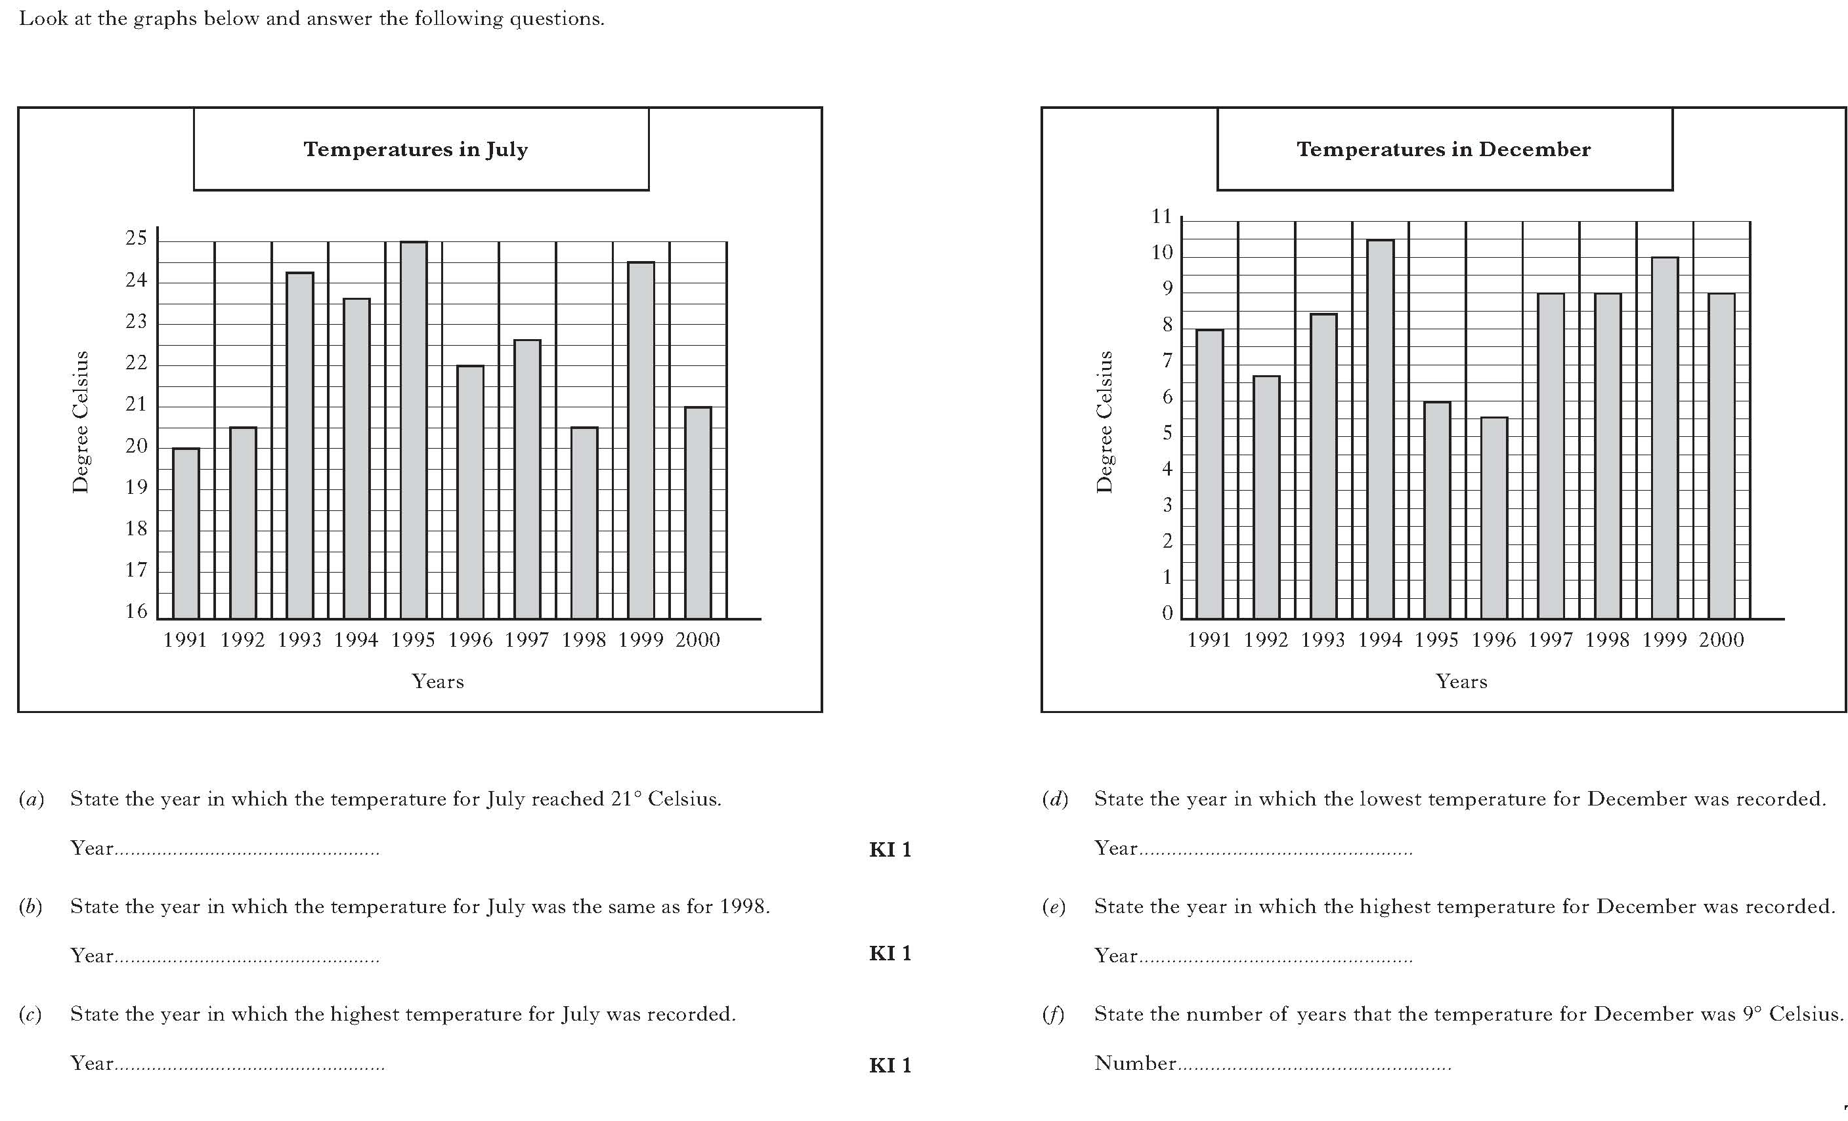
Standard Grade Graphic Communication KI 2007 Q3
Year 2000
Year 1996
Year 1992
Year 1994
Year 1995
Three (1997/98 and 2000)

Slide 4
Standard Grade Graphic Communication KI 2007 Q4
4
5
1
6
3
2
Section or Sectioned elevation
Isometric

Slide 5
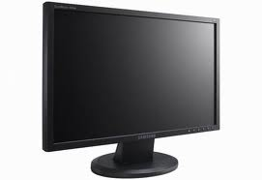
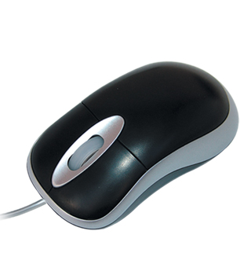
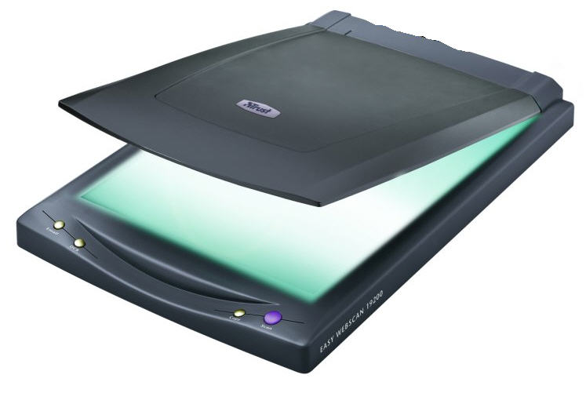
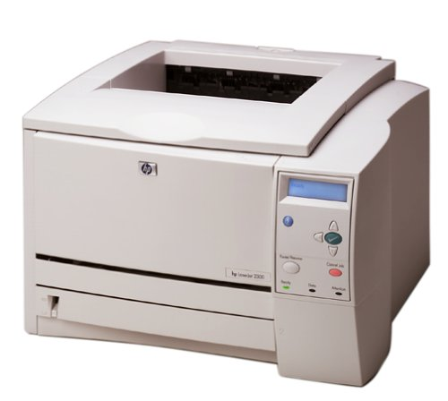
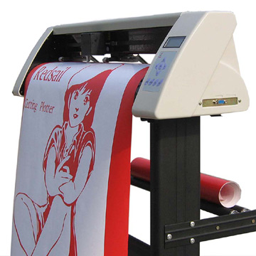
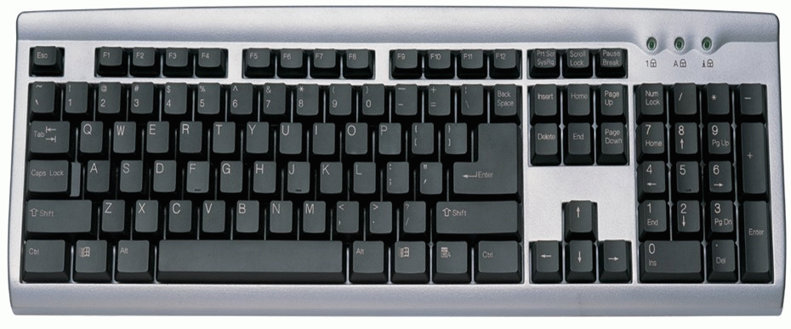
Standard Grade Graphic Communication KI 2008 Q1
A paper copy or printout
In case the computer crashes/so that all data is not lost if you
accidentally delete your work.

Slide 6
Standard Grade Graphic Communication KI 2008 Q2
Green, Blue-green
Yellow, Yellow-green
Orange, Red-Orange
Red-Violet, Violet
Yellow-Orange
Yellow- Green
Red/yellow
Blue/Green
White

Slide 7
Standard Grade Graphic Communication KI 2008 Q3
4
2
5
3
1
Section / Sectional Elevation

Slide 8
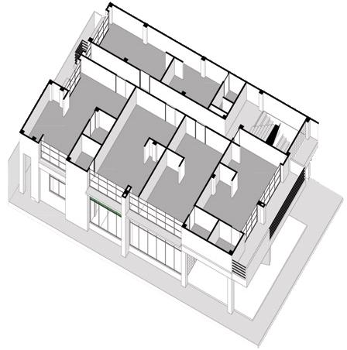
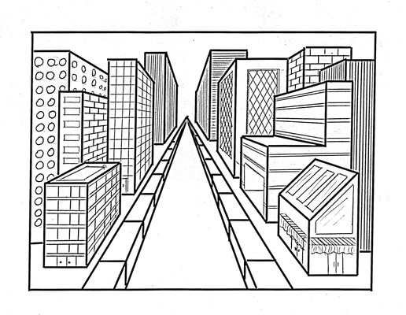
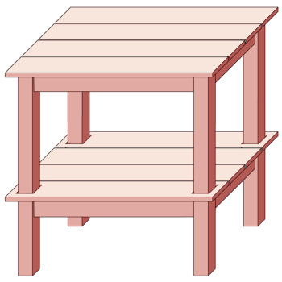
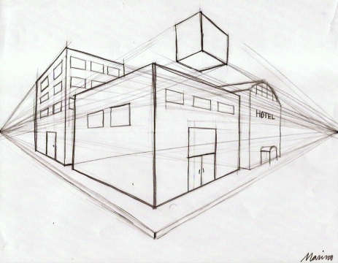
Standard Grade Graphic Communication KI 2008 Q3cont
Isometric
Planometric
Oblique / One and two point Perspective
30°
30°
Planometric
Oblique
1 point perspective
2 point perspective

Slide 9
Standard Grade Graphic Communication KI 2008 Q4
August
Two (April and November)
January
December

