Slide 1
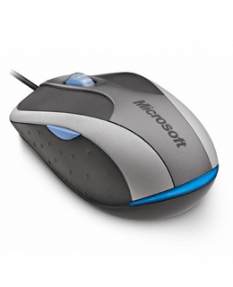
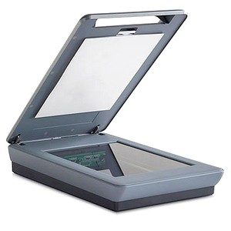
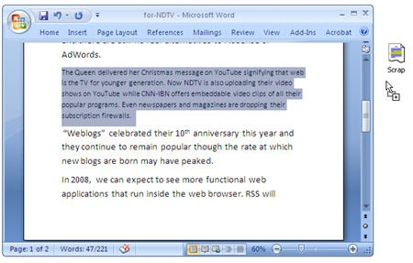
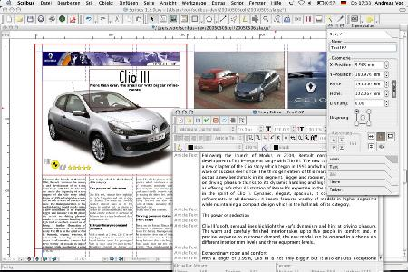
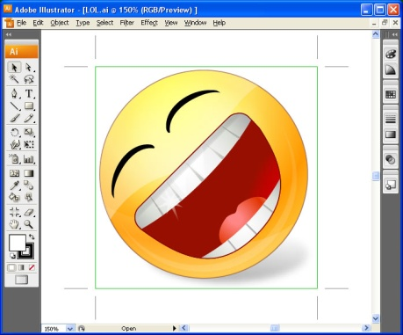
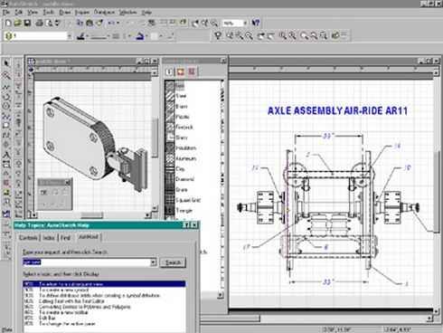
Standard Grade Graphic Communication KI 2005 Q1
Mouse
Scanner
Word processing
Word processing
DTP Desk Top Publishing
DTP – Desk Top Publishing
Paint/Rendering
Rendering/Paint
CAD – Computer Aided Drawing
CAD Computer Aided Drawing

Slide 2
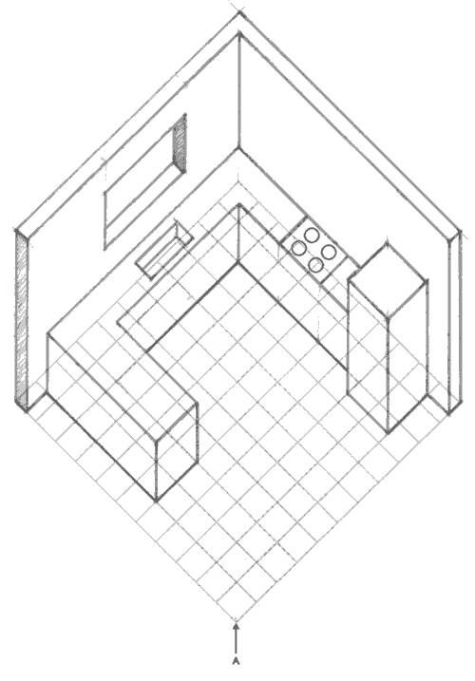
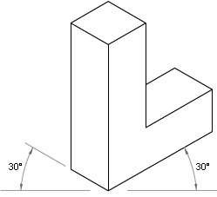
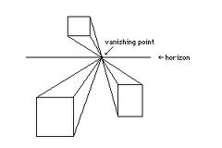
Standard Grade Graphic Communication KI 2005 Q2
Half size
45°
4
3
2
5
6
1
Isometric
Planometric
Section/Sectional elevation
Oblique
Perspective
Isometric
Planometric, One and two point perspective

Slide 3
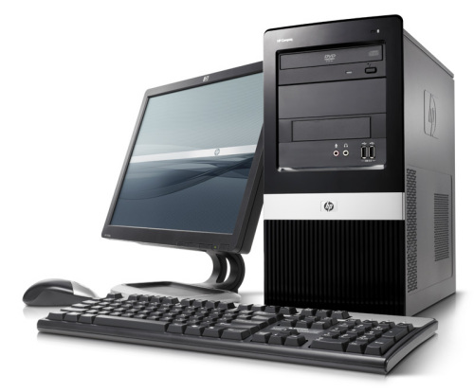
Standard Grade Graphic Communication KI 2005 Q3
In case your work is lost.

Slide 4
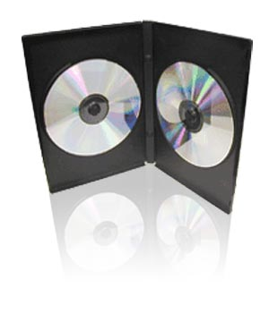
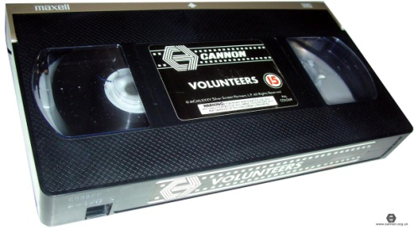
Standard Grade Graphic Communication KI 2005 Q4
December.
May
June
2 (July and August)
October
December

Slide 5
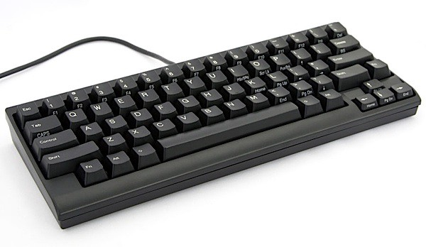
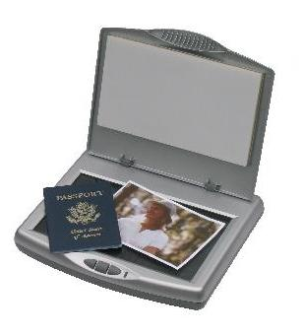
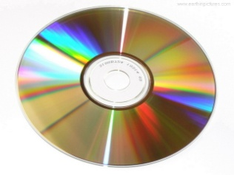
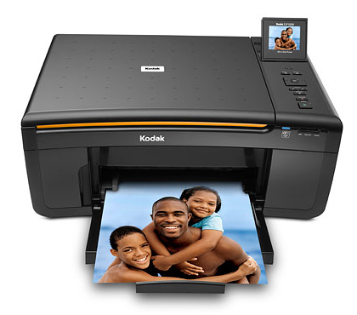
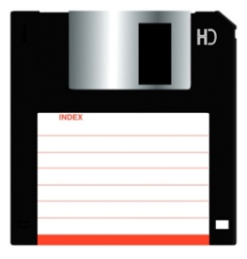
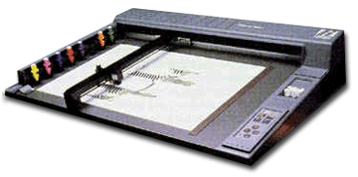
Standard Grade Graphic Communication KI 2006 Q1
Keyboard
Scanner
CD ROM or Floppy disc
Printer
Mouse
Plotter or Printer

Slide 6
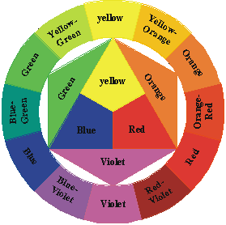
Standard Grade Graphic Communication KI 2006 Q2
Yellow-orange
Yellow-green
Violet/Blue-violet
Red-violet

Slide 7
Standard Grade Graphic Communication KI 2006 Q3
Blue, Blue-green, Green, Yellow-green, Yellow
Orange, Red-orange, Red-violet, Violet
White
Yellow
Blue
Green
Orange
Blue-violet
Yellow-orange

Slide 8
Standard Grade Graphic Communication KI 2006 Q4

