Slide 1
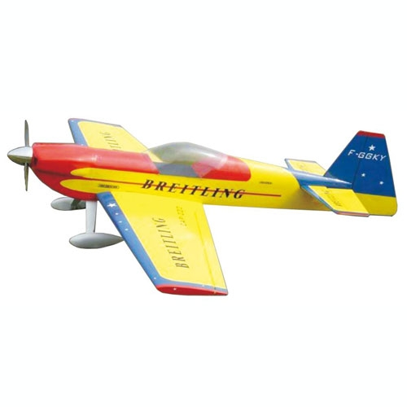
Standard Grade Graphic Communication KI 2003 Q1
Violet, Blue-violet
Red, Red-violet
Yellow-green
Yellow- orange
Secondary colour
Red-violet
Red-orange
Red or Yellow
Blue or Green

Slide 2
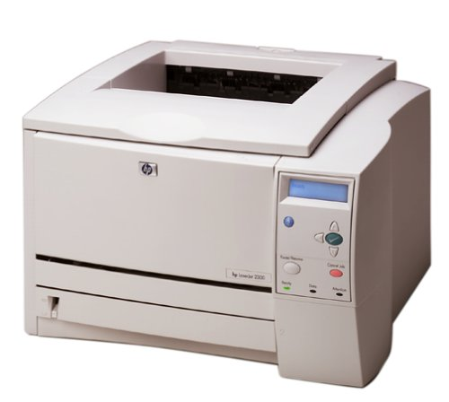
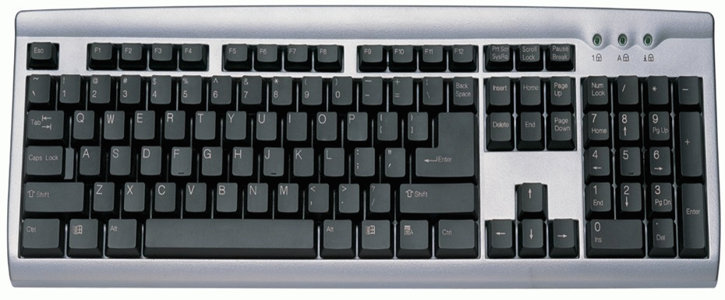
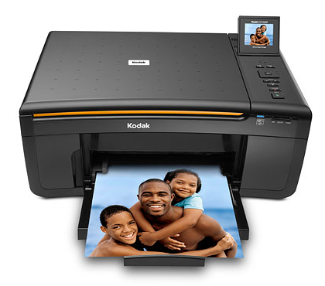
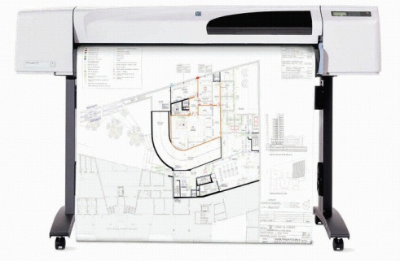
Standard Grade Graphic Communication KI 2003 Q2
Mouse or Keyboard
Keyboard
Printer
Plotter or printer
In case the computer crashes.
Outputting hard copies of line drawings.

Slide 3
Standard Grade Graphic Communication KI 2003 Q3
Mouse or Keyboard
Keyboard
Printer
Plotter or printer
In case the computer crashes.
Outputting hard copies of line drawings.

Slide 4
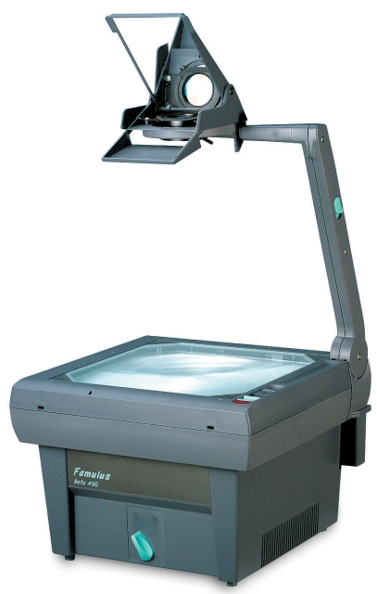
Standard Grade Graphic Communication KI 2003 Q4
Small
SB-400
Delux
1.95
Medium
2.10

Slide 5
Standard Grade Graphic Communication KI 2004 Q1
Cad – Computer Aided Drawing
Laser Printer
Ink jet printer or plotter (any type)
Mouse
Keyboard

Slide 6
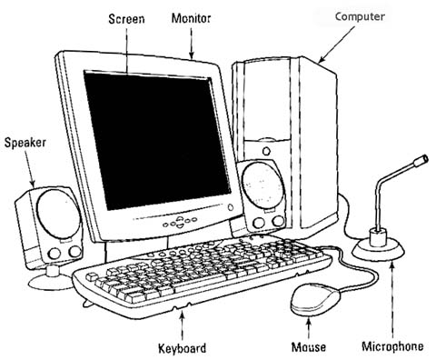
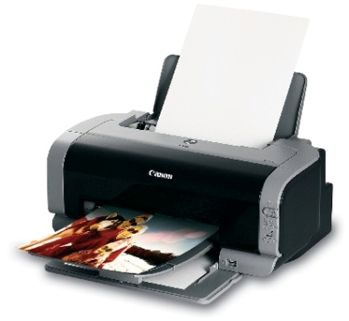
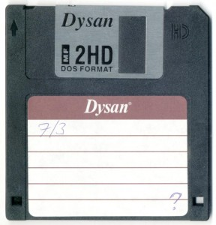
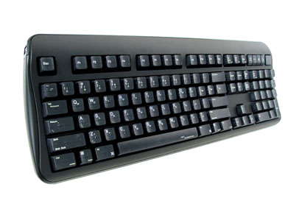
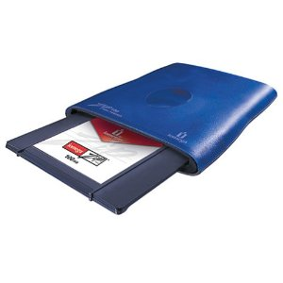
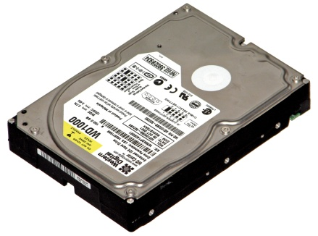
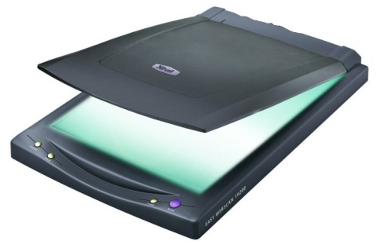
Standard Grade Graphic Communication KI 2004 Q2

Slide 7
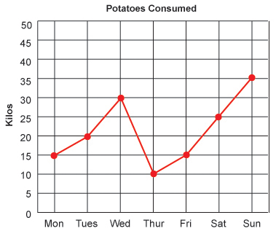
Standard Grade Graphic Communication KI 2004 Q3
Bar Chart
Line Graph
Pie chart
15,000
2001
1998
1999
1997

Slide 8
Standard Grade Graphic Communication KI 2004 Q4
Blue, Blue-violet, Blue-green
Orange, Yellow-orange or Red-orange

