Slide 1
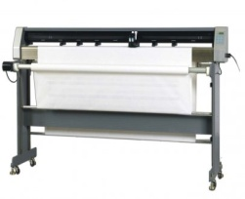
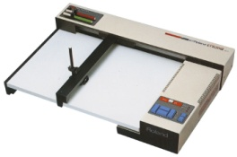
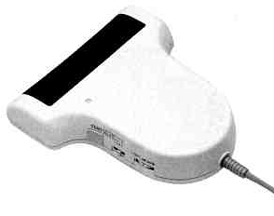
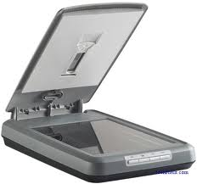
Standard Grade Graphic Communication Credit KI 2011 Q1.
Index
1.
Ability to create a library of commonly used parts/ease of
storage/greater accuracy/layer a drawing.
Easier to edit drawings/creation of new design from existing/
standardisation
Easier to send drawing to other places (e-mail)
Possibility of data loss. Need to train staff.
Possibility of system failure/crash Data security/hacking/
viruses etc
Drum plotter
Flatbed plotter
Scanner (any kind – hand held, flatbed etc)
Digitiser

Slide 2
Standard Grade Graphic Communication Credit KI 2011 Q2.
Index
2.
23
40
Drawing X
Two (2)
Six(6)
Orthograhic

Slide 3
Standard Grade Graphic Communication Credit KI 2011 Q3.
Index
3.
Six (6)
Three (3)
Eleven (11)
Nine (9)
The size of the object being drawn/the amount of detail needed in the drawing.
The size of the paper used to produce the drawing.

Slide 4
Standard Grade Graphic Communication Credit KI 2011 Q4.
Index
4.
Scale/Zoom
Fillet
Delete
Hatch/Pattern fill
Chamfer
Box Array/ Array
Circle
Ellipse
Break
Text
Copy
mirror

Slide 5
Standard Grade Graphic Communication Credit KI 2011 Q5.
Index
5.
DTP – Desk Top Publishing
Illustration/ 3D / Paint package
CAD – Computr aided drawing
Ink jet printer
Laser Printer
Wire Frame
Surface model
Solid model

