Slide 1
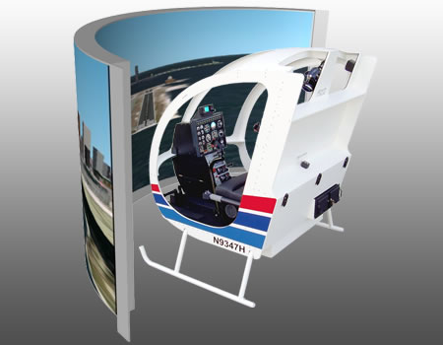
Standard Grade Graphic Communication Credit KI 2010 Q1.
Index
1.
Animations are watched and simulations are interactive/You can affect the outcome in a simulation, you can’t in an animation.
It is safer/It is cheaper
Animation
Many different flying situations can be simulated
Use animations in promotional or sales presentation
To test how the helicopter would behave in a crash situation
Simulator

Slide 2
Standard Grade Graphic Communication Credit KI 2010 Q2.
Index
2.
40
23
Two (2)
Six (6)
Oblique
Planometric
Perspective
To make it easier to understand what the object looks like.
Nine (9)
Fourteen (14)

Slide 3
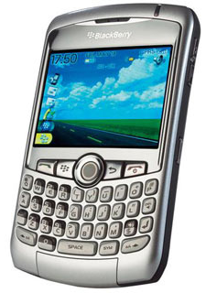
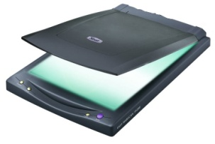
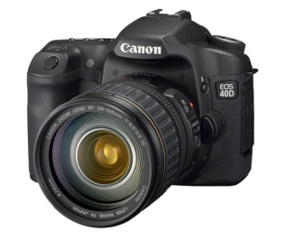
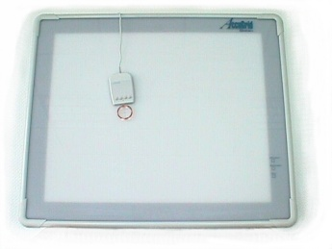
Standard Grade Graphic Communication Credit KI 2010 Q3.
Index
3.
Ability to create a library of commonly used parts. Standardisation
Easier to edit drawings/creation of new design from existing. Storage capacity
Easier to send drawing to other places (e-mail)/shorter lead time/links to CAD-CAM
Time and cost of training staff
Possibility of data loss/possibility of system failure/crash
Data security/hacking/viruses etc
Scanner/Digitiser Graphics Tablet
To ensure that no data is lost and if system fails then data can be recovered up mto that point

Slide 4
Standard Grade Graphic Communication Credit KI 2010 Q4
Index
4.
Easier to edit/zoom in to view in greater detail
Easier to store/transport
Cannot be handled
Can only be viewed on a computer/security of the design as it could be easier to steal
Surface rendered
Wire frame
Solid

Slide 5
Standard Grade Graphic Communication Credit KI 2010 Q5
Index
5.
Exploded isometric
Section
To show how the parts are assembled
To show details of the inside of the
assembly that may not be obvious in the normal elevation.
To give information that you might not see in the normal elevation.
Location or Block plan (scale normally 1:1250)
Site plan (scale normally 1:200)
Floor plan (scale normally 1:50)
North symbol or North point
It is drawn half size

