Slide 1
Standard Grade Graphic Communication Credit KI 2009 Q1.
Index
1.
Designs are easier to edit/Drawings are more accurate/
Standardisation of drawings
New designs from existing/Library of commonly used parts can
be created/Reduced lead time
Drawings are easier to store/Drawings can be sent to other
locations by e-mail
Time taken to learn how to use the software/Cost of the
software, continual need to update software
Accidental data loss/Security of data (hacking)
Viruses
Cont.

Slide 2
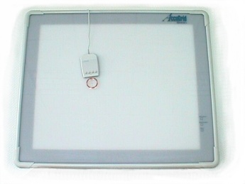
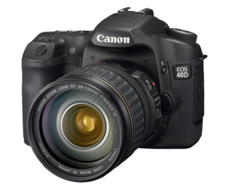
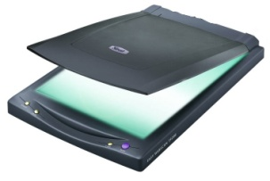
Standard Grade Graphic Communication Credit KI 2009 Q1 Cont.
Index
1.
DTP - Desk Top Publishing
CAD – Computer Aided Drawing
Ilustration/Paint/3D modelling package
Scanner/Digitiser/Digital Camera
The different software use the same operating system/Data can beimported between the different software packages.

Slide 3
Standard Grade Graphic Communication Credit KI 2009 Q2.
Index
2.
Bright and cheerful
Cool and reliable/
contrast with walls
White
In harmony with the floor
(Blue)/contrast with walls
Exciting/Vibrant/Active
Green
Red/Yellow
Blue/Blue-Violet/Green
Green/Blue-Green/Blue-Violet/Violet
Add a primary and secondary colour together
Visual excitement

Slide 4
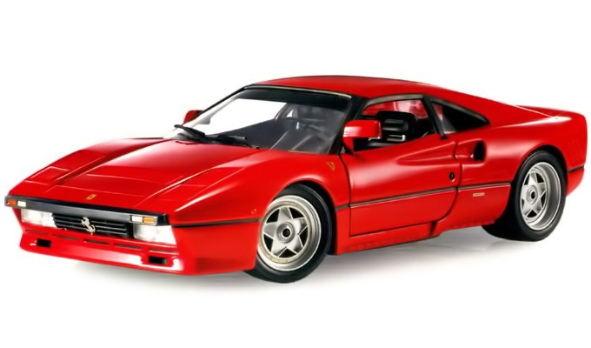
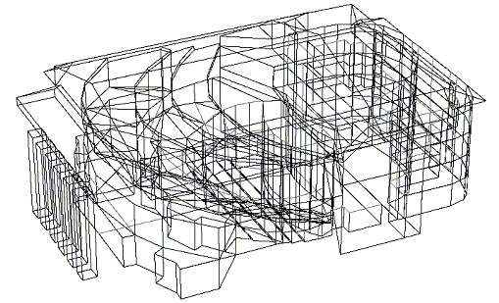
Standard Grade Graphic Communication Credit KI 2009 Q3.
Index
3.
Ease of editing/Ease of testing
Ease of storage/Ease of transporting
Computer models cannot be
touched, no physical interaction
Could be more easily stolen,
data could be corrupted.
Wireframe/Solid
Surface/Surface-rendered
In simulation you interact with the software, in animation you only view the images.
The animation could be used for promotional purposes/To help in the marketing of the car.
To test the car’s aerodynamics/To test how the car would react in a crash situation.

Slide 5
Standard Grade Graphic Communication Credit KI 2009 Q4.
Index
4.
Ο10
Two (2)
six (6)
23
Isometric
73
The size of the object being drawn
The size of the paper being used for the drawing/The amount of detail required for the drawing
Ease of reading the drawings/Drawing can be easily understood because the same symbols and conventions are used no matter who does the drawing

