Slide 1
Standard Grade Graphic Communication Credit KI 2008 Q1.
Index
1.
Animations are watched and simulations are interactive. You can affect the outcome in a simulation, you can’t in an animation
It could be used to show how it is assemble or It could be used to show the doors and drawers opening.
Many different and dangerous situations can be simulated.
It is cheaper than flying a real plane. Pilots can be trained to land in different airports/It is safer than flying a real plane.
How the car will perform in a crash situation.
The aerodynamics of the car can be tested.
Animation

Slide 2
Standard Grade Graphic Communication Credit KI 2008 Q2.
Index
2.
Bright and cheerful/warm/
highly visible/lively/sunny
Warm, exciting,
active, in contrast with yellow
Green, YellowGreen, YellowOrange, Orange
Blue, Blue-Violet,
Violet, RedViolet, Red
Green
Bright and attractive/Visual excitement/Associated with children
Advancing
They would make the store logo and materials easily recognisable/
Company identity
Tone

Slide 3
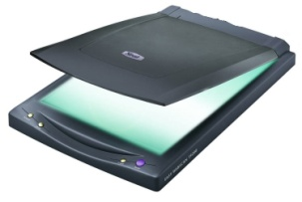
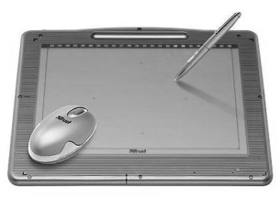
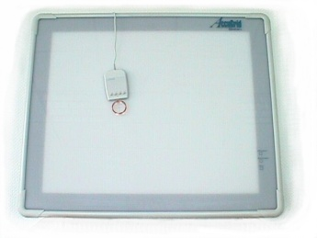
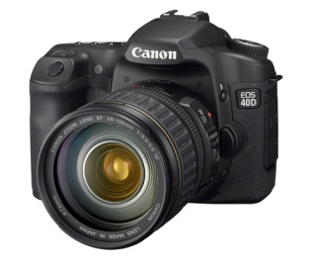
Standard Grade Graphic Communication Credit KI 2008 Q3.
Index
3.
Ease of editing/Storage and retrieval of work
New designs from existing/Standardisation of drawings
Library of commonly used parts/Shorter lead time
Continual need for updating software or operating systems
Possibility of system failure/System crash/Viruses
Data loss/Security/Computer hacking
Scanner
Digitiser/Graphics tablet/Digital camera
Wireframe
Solid
Surface

Slide 4
Standard Grade Graphic Communication Credit KI 2008 Q4.
Index
4.
One (1)
Five (5)
Isometric
Planometric
Oblique
Perspective
Eight (8)
Fourteen (14)

Slide 5
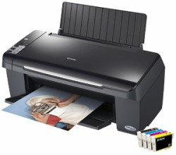
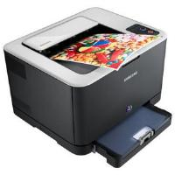
Standard Grade Graphic Communication Credit KI 2008 Q5.
Index
5.
DTP - Desk Top Publishing
CAD – Computer Aided Drawing
Illustration or Rendering software
Inkjet Printer
Colour Laser Printer

