Slide 1
Standard Grade Graphic Communication Credit KI 2007 Q1
Index
1.
Box Array
Zoom, Scale, Magnify
Fillet
Mirror
Copy
Chamfer
Rotate
Hatch/Pattern fill
Break
Circle
Erase
Ellipse

Slide 2
Standard Grade Graphic Communication Credit KI 2007 Q2
Index
2.
Ο20
70
z
• dimension line
• arrow heads
• leader line
• text in correct position
Three (3)
Five (5)
Exploded isometric
Internal details of an object are shown more clearly than they would be if drawn as hidden detail. To see the inside of an object

Slide 3
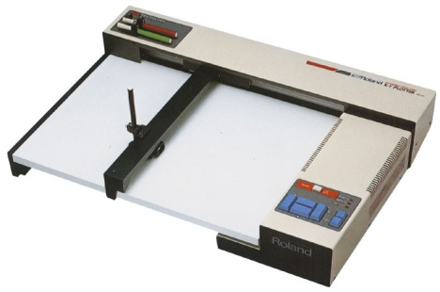
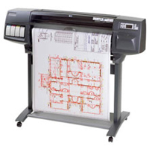
Standard Grade Graphic Communication Credit KI 2007 Q3
Index
3.
New designs from existing designs
Use of a standard template Use of a CAD library
Shorter lead time/ease of editing
An area of a drawing that has been drawn in order that it can be viewed or turned off if not required, ie the plumbing or electrics on a building drawing could be drawn on separate layers and then be printed/viewed together or separately as required
Drum
Flatbed
Software packages that use the same operating system so files can be imported or moved between different packages
Easier to edit/Easier to transportEasier to store/less expensive
Easier to store/less expensive

Slide 4
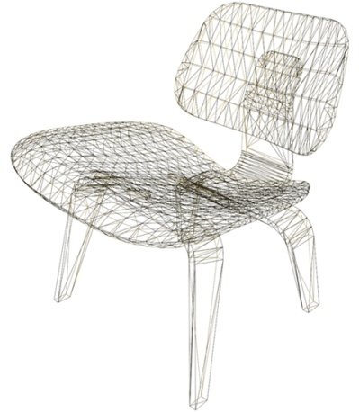
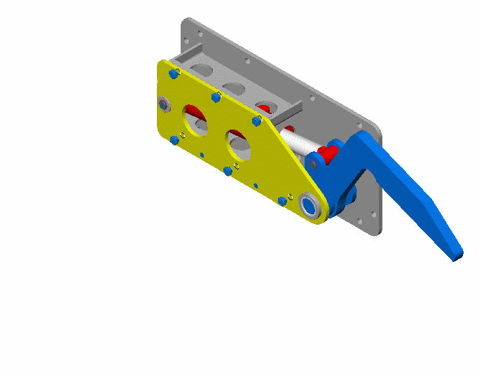
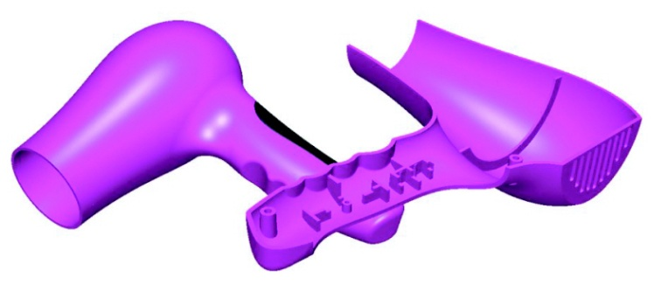
Standard Grade Graphic Communication Credit KI 2007 Q3 cont.
Index
3.
Wire frame
or Solid
Surface

Slide 5
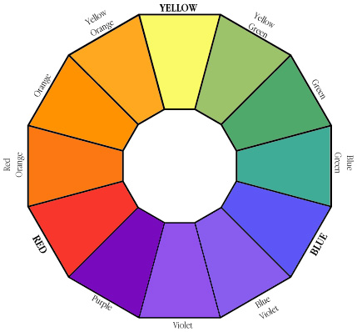
Standard Grade Graphic Communication Credit KI 2007 Q4.
Index
4.
Associated with cleanliness/Goes with any colour
Blue
Associated with the environment/
associated with safety
Yellow
Orange
Holds great power of attraction
Excitement/speed
Green/Yellow-green
Yellow-orange/Orange
Blue-green or Green
Red/Red-orange/Orange/Yellow-orange/Yellow
Visual excitement

