Slide 1
Standard Grade Graphic Communication Credit KI 2006 Q1
Index
1.
Drawings are more accurate, easier to edit, standardisation of formats, new designs from existing designs, use of libraries of commonly used parts, reduction of lead-time. Ability to e-mail.
Work can be lost if the computer crashes, work could be corrupted by viruses, work could be stolen or “hacked”, constant need to update system, constant need to update software.

Slide 2
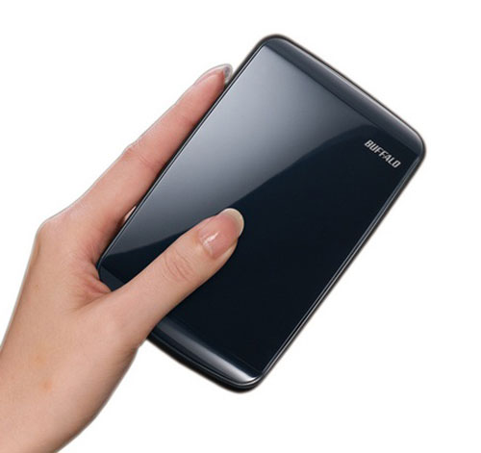
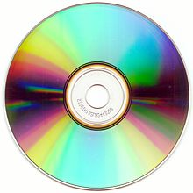
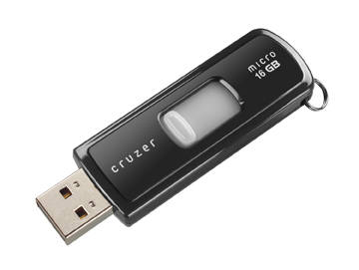
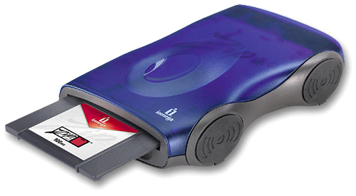
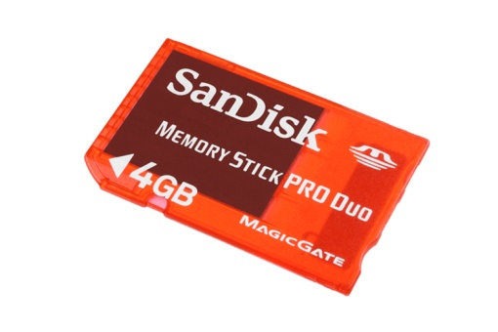
Standard Grade Graphic Communication Credit KI 2006 Q1Cont.
Index
1.
Size of paper used, size of the subject being drawn.
British Standards.
Flat bed Plotter or Drum plotter
Laser printer
Flash drive, Zip drive, and portable hard drive, DVD-ROM, CD-ROM, Pen Drive, Solid State Storage Device/Memory stick.

Slide 3
Standard Grade Graphic Communication Credit KI 2006 Q2.
Index
2.
Blue
Red
Yellow, Yellow-green
Blue-green, Blue
Would make the room seem smaller, or warmer.
Would make the room seem larger, or cooler.
Any warm colour.
Any cool colour
Clean, pure.
Warm, cheerful, sunny, happy, appetising, healthy.
Cool, reliable, sophisticated, formal, classy.

Slide 4
Standard Grade Graphic Communication Credit KI 2006 Q3.
Index
3.
Section, Sectional elevation
True shape
Exploded isometric
Exploded view
Development
Drawing is half size
To show details inside the object
To see the true dimensions of the cut surface
To show all the individual components of an assembly separately, in line with how they fit.

Slide 5
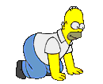
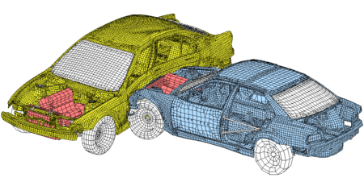
Standard Grade Graphic Communication Credit KI 2006 Q4.
Index
4.
In simulations you interact with the programme, with animations you only watch the screen.
Animation
It is safer, cheaper.
Modifications can be made much faster.
The moving parts of the chair can be demonstrated to show how it works/The moving parts of the chair can be shown without the need to take the actual chair to the clients.

Slide 6
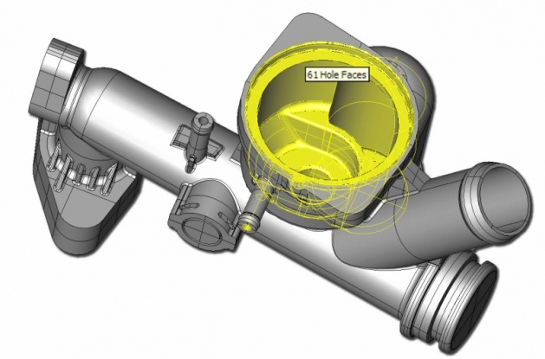
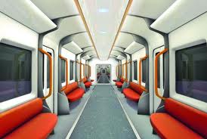
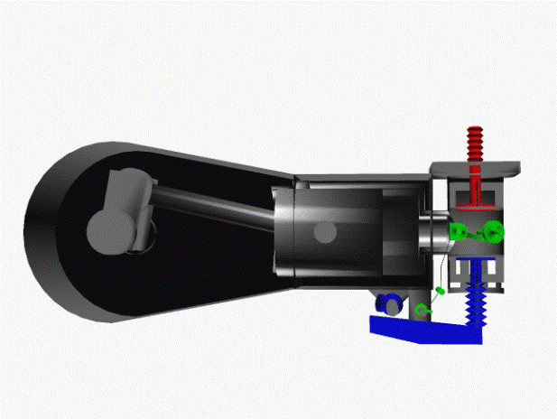
Standard Grade Graphic Communication Credit KI 2006 Q5.
Index
5.
Easier to edit, easier to store, easier to transport.
Can be used to test situations/designs before they are built.
Model can not be touched/no physical interaction, data could be corrupted, could be more easily stolen.
Wireframe, Solid
Surface.

