Slide 1
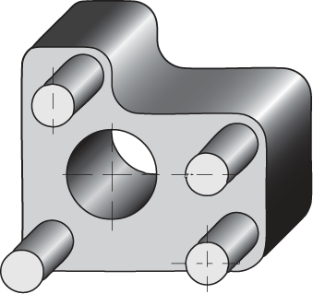
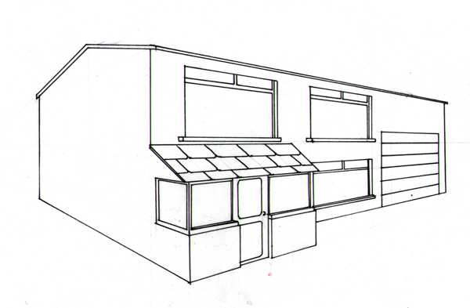
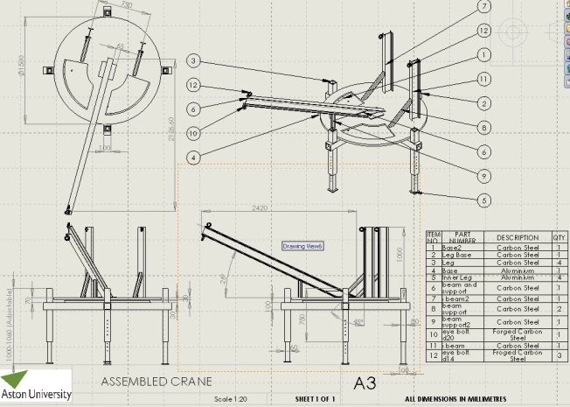
Standard Grade Graphic Communication Credit KI 2005 Q1
Index
1.
Oblique
Circles remain circles.
1/2 size
Two point perspective
45°
It is more realistic
The further away from the spectator point the smaller the object becomes.
VP
VP
Isometric
Planometric
To give all required information, including all dimensions, which allow production of the new design.
Drawing is full size.

Slide 2
Standard Grade Graphic Communication Credit KI 2005 Q2
Index
2.
Drawing X
Two (2)
Five (5)
Nine (9)
Eleven (11)

Slide 3
Standard Grade Graphic Communication Credit KI 2005 Q3
Index
3.
Drawing different aspects or parts of a drawing on separate layers. These can be viewed separately or together.
Building drawing with walls, dimensions, electrics
and plumbing, all drawn on separate layers.
Surface rendered or Surface model
Wire frame or Solid
Easier to edit/easier to store
Easier to transport ie modem/E-mail

Slide 4
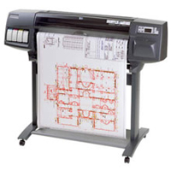
Standard Grade Graphic Communication Credit KI 2005 Q3 Cont.
Index
3.
CAD – Computer Aided Drawing
DTP – Desk Top Publishing
Paper moves in one axis, pen moves in the other.

Slide 5
Standard Grade Graphic Communication Credit KI 2005 Q4
Index
4.
Fillet
Text
Ring Array
Chamfer
Dimension
Mirror
Break
Ellipse
Rotate
Circle
Hatch/ Pattern fill
Copy

Slide 6
Standard Grade Graphic Communication Credit KI 2005 Q5
Index
5.
Three (3)
So as to make the drawings easy to read, as everyone uses the same conventions. This means there should be no confusion caused by not being able to understand the used conventions. Standardisation of conventions.
R19
67

