Slide 1
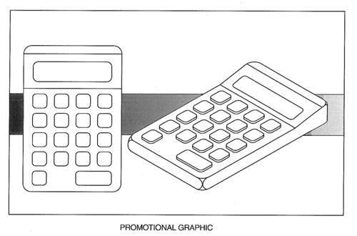
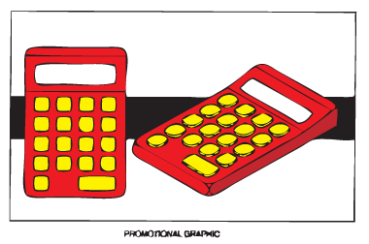
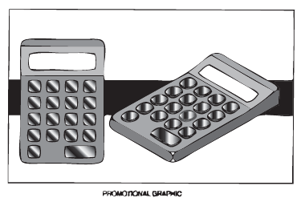
Standard Grade Graphic Communication Credit KI 2003 Q1
Index
1.
Visual excitement, Attractive to children
Sophisticated, Expensive, High tech, Modern
Blue or Brown
Yellow/Yellow-orange/red-orange/red
Green/Blue-green/blue-violet/violet
To give depth to the graphic
To give the product prominence
Warm colours
Cool colours

Slide 2
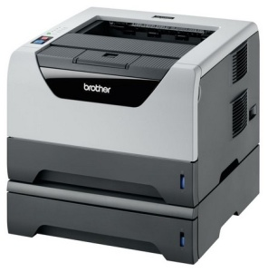
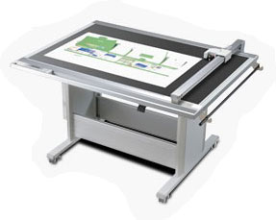
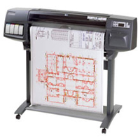
Standard Grade Graphic Communication Credit KI 2003 Q2
Index
2.
Section
Planometric
True Shape
Development
To see detail of the inside of an object without hidden edges making it difficult to interpret
To show a client the interior of a room based on the given plan
Drawn half size
Easier to understand
Laser printer
Flat bed plotter or Drum plotter

Slide 3
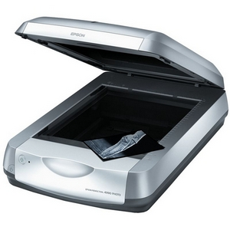
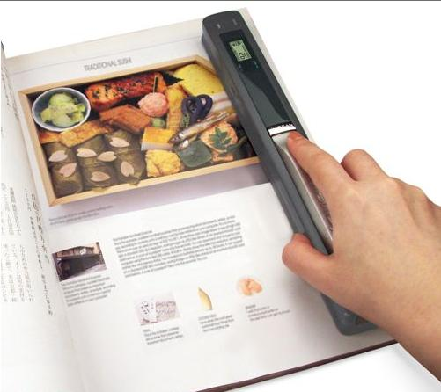
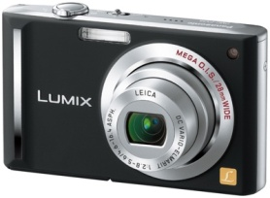
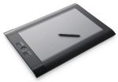
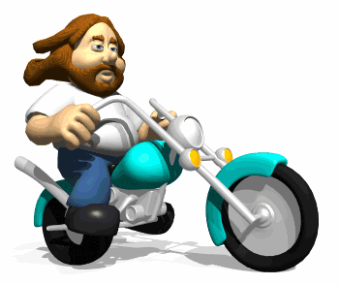
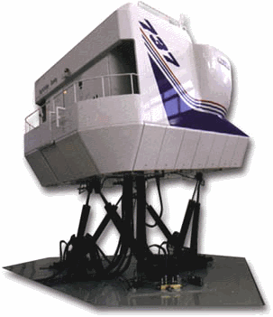
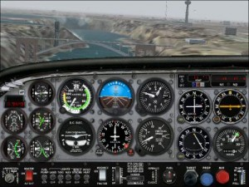
Standard Grade Graphic Communication Credit KI 2003 Q3
Index
3.
Drawings are more accurate, Easier to Edit
Standardised drawings, Use of libraries
Ability to E-Mail,reduction in lead time
Lost work if computer crashes, Viruses
Work can be stolen or hacked
A database of commonly used parts
stored in the computer
Drawing different aspects of a drawing on different layers that can be turned on or off
Scanner (hand or flatbed)
Digitiser, Digital camera, Graphics tablet
Easier to edit, Easier to store, Accurate
Faster to produce, Can be emailed.
Interactive software that simulates real life.
Flight simulator
Animation
Flight simulator

